Slide 1




Marine Corps Logistics Base Albany
Commanding Officer’s Quarterly Safety Council
FY26 1st Quarter – 4 February 2026
PURPOSE
The purpose of the Safety Council is to review the installation and tenant safety performance and program effectiveness, to recommend changes to reduce unsafe practices and to strengthen the overall program.
(MCO 5100.29C Vol 1, Chap. 2, Para. 0204.F)
This meeting serves as the command:
Safe Driving Council (MCO 5100.29C, Vol 3, Chap. 7, Para. 0708.I)
Ergonomics Committee Meeting (NAVMC DIR 5100.8 Chap. 19, Para. 19003)
AGENDA
Goals
Performance Metrics
Inspections
Unit Safety Reports
GOV Fleet Safety
Traffic Safety
MCFD
MCPD
Base Traffic Court
Injury Compensation
RASP
Ergonomics
SACO
RODS
Explosive Safety
Hearing Conservation
Medical Surveillance
IH Surveys
Safety Training
VPP Activities
Safety Awards
Open Discussion
CO Guidance

Slide 2



Emergency Evacuation Coffman Hall Evacuation Routes
Muster by the cannons
2

Slide 3

CY25 Command Safety Program Goal MCLB Albany
GOAL: Reduce Life Safety Code Findings by 30%
Background: Risk Management has identified a significant increase in Life Safety Code findings, with a 23% surge in CY24 compared to CY23, accounting for over 20% of all safety findings in the past five years. Many of these hazards could have been identified and resolved by employees, highlighting a need for increased awareness and responsibility. This goal focuses on addressing these hazards by ensuring regular inspections of fire extinguishers, maintaining functional emergency/exit lights, and keeping fire exits clear. These actions aim to reduce safety risks, improve compliance, and foster a culture of safety, ultimately ensuring a safer and more efficient workplace while supporting our mission.
References: 29 CFR 1910 Subpart E and NFPA 101-2024 each require compliance with established fire safety standards to preserve the safety and health of employees and protect facilities.
Goal: Reduce Life Safety Code hazards by 30%, with no more than 25 findings total during CY25, as tracked in
Target Date: 30 June 2025
Goal Leader: Division Directors, Special Staff and HQ Company Commander
Goal Progress Reporting: Division Directors and HQ Company Commander will brief the progress of this goal at the Commanding Officer’s Quarterly Safety Council.
RMI-SIR
Completed
 | Objective | Objective Leader | Completion Date
1 | Division Directors will formally appoint Fire Wardens in writing for each work area, shop, or facility under their responsibility. | Division Directors, Special Staff and HQ Company Commander | 28 February 2025
2 | Division Directors will ensure fire wardens complete initial or refresher training through MCLBA’s Fire Prevention section, equipping them with the knowledge and skills necessary to conduct fire safety inspections effectively. | Division Directors, Special Staff and HQ Company Commander | 31 March 2025
3 | Division Directors will ensure 90% of the workforce completes the Fire Prevention and Portable Fire Extinguisher Training and Education (1024) module in ESAMS. | Division Directors, Special Staff and HQ Company Commander | 1 April 2025
4 | Division Directors will ensure that every employee participates in at least one documented safety and occupational health inspection of their work areas, with a specific focus on identifying Life Safety Code hazards such as uninspected fire extinguishers, non-working emergency/exit lights, and blocked fire exits. | Division Directors, Special Staff and HQ Company Commander | 30 June 2025
Assessment Criteria
No Action | In-Progress | Completed

Slide 4
CY26 Command Safety Program Goal MCLB Albany
GOAL: Establish RMI Accounts for 90% of Marines and Civilian Marines
Background: As required by ALNAV 040/25, all Department of the Navy (DON) commands must fully transition to the Risk Management Information (RMI) system for mishap reporting and safety program management. To support this transition, 90% of Marines and Civilian Marines must have RMI accounts set up by the target date to ensure the workforce is prepared to use the system for reporting mishaps and managing safety data effectively.
References: ALNAV 040/25: Mandatory use of the Risk Management Information System Streamlined Incident Reporting and Safety Program Management Modules for Managing Safety Programs.
Goal: Establish RMI Accounts for 90% of Marines and Civilian Marines
Target Date: 30 June 2026
Goal Leader: Division Directors, Special Staff and HQ Company Commander
Goal Progress Reporting: Division Directors and HQ Company Commander will brief the progress of this goal at the Commanding Officer’s Quarterly Safety Council.
 | Objective | Objective Leader | Completion Date
1 | Provide a tool to assist in the setup and establishment of individual RMI accounts to ensure an efficient process for account creation. | Risk Management Staff | 30 January 2026
2 | Create and assign individual RMI accounts to Marines and Civilian Marines to ensure all can access and use the system for mishap reporting. | Division Directors, Special Staff and HQ Company Commander | 27 February 2026
3 | Assign the appropriate access levels to supervisors and unit safety representatives to ensure they have the necessary permissions to manage and oversee mishap reporting, safety data, and safety program management in RMI. | Division Directors, Special Staff and HQ Company Commander | 31 March 2026
4 | Provide training to supervisors and unit safety representatives on how to properly submit mishaps in RMI to ensure they understand the correct procedures for accurate and timely reporting. | Division Directors, Special Staff and HQ Company Commander | 30 June 2026
Assessment Criteria
No Action | In-Progress | Completed

Slide 5
Performance Metrics as of 31 December 25
CY21-CY25 Military RMI-SIR Cases
CY21-CY25 Civilian Lost Day Cases
6
2
Notes:
Military RMI-SIR Cases:
9/20/22 – SNM Bitten by an insect on the hand – No lost time
7/6/22 – SNM Playing PT soccer in gym. Marine stepped on foot and suffered fractured right foot -30 Days Light Duty
5/9/22 – SNM right hand struck while repairing motor assembly of POV. OFF Duty – 7 days light duty
3/12/22 – SNM left pinky finger on left hand was dislocated attempting to catch a football. OFF Duty – Splint 30 Days
3/17/21 – SNM struck bench at home and broke right hand. OFF Duty – 3 days Lost Time and 30-90 days Light Duty
3/22/21 – SNM hit back of head against a cabinet shelf left open. OFF Duty – 2 days Lost Time and 18 days Light Duty
5/18/21 – SNM rolled and sprained left ankle during personal PT. OFF Duty – 14 days Light Duty
5/24/21 – SNM smashed middle finger on left hand between kennel food bowl and wall. ON Duty – Splint 30 days
7/24/21 – SNM bitten by dog on right elbow. OFF Duty – Medication
Civilian Lost Day Cases:
9/6/22 – While performing a training exercise, employee was accidentally dropped onto the floor by another employee – 5 days Lost Time
8/10/22 – Employee fell and struck head while attempting to sit in office chair. 4 days Lost Time
3/29/21 – Employee struck in forehead with toy. 3 days Lost Time

Slide 6



OSHA Injury/Illness Rates as of 31 Dec 25
OSHA RECORDABLE CASES
Calendar Year | # of Cases
2014 | 9
2015 | 8
2016 | 8
2017 | 6
2018 | 5
2019 | 8
2020 | 5
2021 | 5
2022 | 5
2023 | 4
2024 | 2
2025 | 4
MCLB Albany Injury Rates (31 Dec 25)
MCLB Albany | CY13 | CY14 | CY15 | CY16 | CY17 | CY18 | CY19 | CY20 | CY21 | CY22 | CY23 | CY24 | CY25
DART | 1.0 | 0.5 | 0.7 | 0.5 | 0.4 | 0.5 | 0.2 | 0.8 | 0.6 | 0.4 | 0.7 | 0.9 | 0.0
TCIR | 2.4 | 1.5 | 1.5 | 1.5 | 1.5 | 1.1 | 0.9 | 1.4 | 0.9 | 1.0 | 0.9 | 0.9 | 1.0
NAICS | CY13 | CY14 | CY15 | CY16 | CY17 | CY18 | CY19 | CY20 | CY21 | CY22 | CY23 | CY24 | MCLB Albany 3-Year Average (CY21-CY23)
DART | 1.9 | 1.5 | 1.2 | 1.8 | 2.1 | 1.5 | 1.8 | 3.2 | 2.8 | 3.2 | 1.8 | 1.2 | 0.6
TCIR | 3.8 | 3.1 | 2.3 | 3.2 | 3.5 | 3.5 | 3.0 | 4.5 | 3.8 | 3.8 | 3.2 | 2.1 | 1.0
Notes:
CY22
1st Quarter
None
2nd Quarter
5/9/22 – SNM right hand struck while repairing motor assembly of POV. OFF Duty – 7 days light duty
3rd Quarter
8/10/22 – Employee fell and struck head while attempting to sit in office chair. 4 days Lost Time
9/6/22 – While performing a training exercise, employee was accidentally dropped onto the floor by another employee – 5 days Lost Time
4th Quarter

Slide 7


Inspections
FY26 – 1st Qtr
CDC
I&E
LSD
MARCORLOGCOM
DSC
HRO
PHA
Georgia Army National Guard
2nd Network Battalion

Slide 8
FY22 - FY26 Inspection Findings
(Includes All Organizations) as of 31 Dec 25
Risk Assessment Code for all findings
 | FY 22 | FY 23 | FY 24 | FY 25 | FY 26
RAC 1 | 0 | 0 | 0 | 0 | 0
RAC 2 | 0 | 0 | 0 | 0 | 0
RAC 3 | 12 | 9 | 14 | 3 | 0
RAC 4 | 180 | 222 | 287 | 211 | 0
RAC 5 | 46 | 36 | 54 | 29 | 0
Total | 238 | 267 | 355 | 243 | 0
# of Findings
Notes:
This information includes data from the following inspections performed for FY22:
1st Qtr – 15 small tenants, I&E, and MCCS
2nd Qtr – PSD, HQ CO, Special Staff, OTD, Comptroller, Manpower, CISD, MCCS, PPA, and PowerWorks.
3rd Qtr – LSD, MFSC, and DLA; pending CDC, and I&E.
4th Qtr –
This information includes data from the following inspections performed in FY23
1st Quarter – CDC, I&E, LSD, MARCORLOGCOM, 15 Small Tenants

Slide 9
FY22 - FY26 Inspection Findings
MCLB Albany as of 31 Dec 25
Risk Assessment Code for all findings
 | FY 22 | FY 23 | FY 24 | FY 25 | FY 26
RAC 1 | 0 | 0 | 0 | 0 | 0
RAC 2 | 0 | 0 | 0 | 0 | 0
RAC 3 | 2 | 7 | 11 | 2 | 0
RAC 4 | 73 | 110 | 75 | 96 | 0
RAC 5 | 43 | 22 | 60 | 28 | 0
Total | 118 | 139 | 146 | 126 | 0
# of Findings
Notes:
This information includes data from the following inspections performed for FY22:
1st Qtr - I&E and MCCS
2nd Qtr – PSD, HQ CO, Special Staff, OTD, Comptroller, Manpower, CISD, and MCCS.
3rd Qtr – DDAG, LSD, CDC (quarterly), I&E
4th Qtr - …

Slide 10
Safety and Occupational Health Inspections
FY24 Abatement Efficiency Index: 98%
1% or (4) of the (355) Findings identified by Safety & Occupational Health Inspections during FY24 are not documented as abated within 30 days.
Supervisor Responsibility: “Provide for or ensure abatement of all identified workplace OSH deficiencies.” NAVMC Dir 5100.8, Chap. 7 Para 7004.4.f
Open Findings as of 31 Dec 25
UNIT | Number | RAC
PSD | 2 | 4
General Accounts | 2 | 4
Total | 4
The Unit Safety Officer is responsible for maintaining a hazard abatement log, monitoring the corrective actions (Work Requests) taken, and reporting the status to the Risk Management Office.
Notes:
24 of the 161 findings for FY22 are still open as of 27 Apr 22, which gives us an 83% Abatement Efficiency index.
1st Qtr data input - 15 small tenants, I&E, and MCCS
2nd Qtr data input - PSD, HQ CO, Special Staff, OTD, Comptroller, Manpower, CISD, MCCS, PPA, and PowerWorks.
3rd Qtr data input - includes LSD, MFSC, and DLA data, CDC and I&E.
4th Qtr data input -

Slide 11
Safety and Occupational Health Inspections
FY25 Abatement Efficiency Index: 93%
6% or (16) of the (243) Findings identified by Safety & Occupational Health Inspections during FY25 are not documented as abated within 30 days.
Supervisor Responsibility: “Provide for or ensure abatement of all identified workplace OSH deficiencies.” NAVMC Dir 5100.8, Chap. 7 Para 7004.4.f
Open Findings as of 31 Dec 25
UNIT | Number | RAC
DLA | 1 | 4
Ga National Guard | 1 | 4
PSD | 3 | 4
MCCS | 11 | 3/4
Total | 16
The Unit Safety Officer is responsible for maintaining a hazard abatement log, monitoring the corrective actions (Work Requests) taken, and reporting the status to the Risk Management Office.
Notes:
24 of the 161 findings for FY22 are still open as of 27 Apr 22, which gives us an 83% Abatement Efficiency index.
1st Qtr data input - 15 small tenants, I&E, and MCCS
2nd Qtr data input - PSD, HQ CO, Special Staff, OTD, Comptroller, Manpower, CISD, MCCS, PPA, and PowerWorks.
3rd Qtr data input - includes LSD, MFSC, and DLA data, CDC and I&E.
4th Qtr data input -

Slide 12
Safety and Occupational Health Inspections
FY26 Abatement Efficiency Index:
(0) of the 0 Findings identified by Safety & Occupational Health Inspections during FY23 are not documented as abated within 30 days.
Supervisor Responsibility: “Provide for or ensure abatement of all identified workplace OSH deficiencies.” NAVMC Dir 5100.8, Chap. 7 Para 7004.4.f
Open Findings as of 31 Dec 25
UNIT | Number | RAC
Total | 0
The Unit Safety Officer is responsible for maintaining a hazard abatement log, monitoring the corrective actions (Work Requests) taken, and reporting the status to the Risk Management Office.
Notes:
24 of the 161 findings for FY22 are still open as of 27 Apr 22, which gives us an 83% Abatement Efficiency index.
1st Qtr data input - 15 small tenants, I&E, and MCCS
2nd Qtr data input - PSD, HQ CO, Special Staff, OTD, Comptroller, Manpower, CISD, MCCS, PPA, and PowerWorks.
3rd Qtr data input - includes LSD, MFSC, and DLA data, CDC and I&E.
4th Qtr data input -

Slide 13
Report of Near Miss
Risk Management no valid Near Miss* Reports for this quarter
*A Near Miss is defined as: Conditions that exist or incidents that occur without injury or property damage. Near misses include unsafe or unhealthful actions, behaviors, or working conditions that did not result in a mishap. (MCLBAO P5100.1M)
^{4th} Quarter CY25
Alisha Montieth
Safety Specialist/Program Manager
639-7272
Notes:
This is a summary of the near miss reports submitted for the 2nd quarter for the Calendar Year.
We had a total of 2 valid Near Miss reports submitted during the 2nd quarter.
Slips, Trips and Fall is leading in the trends of near miss reported followed by other incidents.
A break down of near miss reports are shown by Divisions.

Slide 14
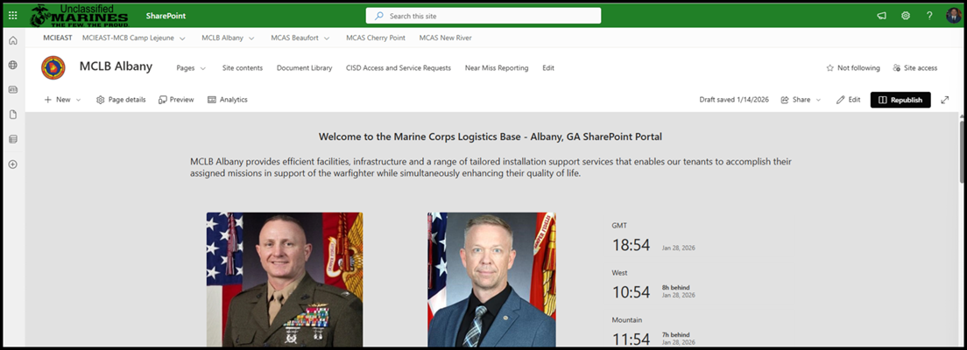


Report of Near Miss
New Near Miss Reporting Links
Use the following link: https://forms.osi.apps.mil/Pages/ResponsePage.aspx?id=2kzE9MYYsEaA8uKQByRE_bPp0qBmf7hHtiFVGE3smrZUMFVYUzg5NTNKSk1PWUdUS1lOTVhEWUtJRy4u
Visit the MCLBA Risk Management page at https://www.albany.marines.mil/Resources/MCLB-Offices-Staff/Risk-Management-Office/ and click on the Near Miss Link.
At the top of the Command’s SharePoint homepage; look for and click on “Near Miss Reporting.” Complete the document and submit.
Notes:
This is a summary of the near miss reports submitted for the 2nd quarter for the Calendar Year.
We had a total of 2 valid Near Miss reports submitted during the 2nd quarter.
Slips, Trips and Fall is leading in the trends of near miss reported followed by other incidents.
A break down of near miss reports are shown by Divisions.

Slide 15
Unit Safety Reports
Briefing Order:
H&S Company
OTD
Manpower
Comptroller
LSD
CISD
I&E
PSD
MCCS
DLA
Notes:
Units with a reported mishap or injuries will brief their information.
Brief by exception. Slides are hidden, but we maintain the data.

Slide 16



Headquarters Company
 | Objective | Objective Leader | Completion Date
1 | Division Directors will formally appoint Fire Wardens in writing for each work area, shop, or facility under their responsibility. | Division Directors, Special Staff and HQ Company Commander | 28 February 2025
2 | Division Directors will ensure fire wardens complete initial or refresher training through MCLBA’s Fire Prevention section, equipping them with the knowledge and skills necessary to conduct fire safety inspections effectively. | Division Directors, Special Staff and HQ Company Commander | 31 March 2025
3 | Division Directors will ensure 90% of the workforce completes the Fire Prevention and Portable Fire Extinguisher Training and Education (1024) module in ESAMS. | Division Directors, Special Staff and HQ Company Commander | 1 April 2025
4 | Division Directors will ensure that every employee participates in at least one documented safety and occupational health inspection of their work areas, with a specific focus on identifying Life Safety Code hazards such as uninspected fire extinguishers, non-working emergency/exit lights, and blocked fire exits. | Division Directors, Special Staff and HQ Company Commander | 30 June 2025
NO ACTION IN PROGRESS COMPLETED
Notes:
Quadrant 1-Injury / rate chart- no change-fill in data sheet and display the chart.
Quadrant 2-OSHA Data. We have filled in the previous data. Put in your current information. Near miss will include any from your personnel we have AND any you have received that we did not.
Quadrant 3 Property damage. List any you have had. Previous quarters should be up-to-date. We want cumulative for the CY.
Quadrant 4

Slide 17
Narrative of Military RMI-SIR Cases CY25
Qtr. | Date | Narrative | Status | Results
1st Qtr. |  | NONE
2nd Qtr. |  | NONE
3rd Qtr. |  | NONE
4th Qtr. | 5 Dec 25 | SNM passed out during SgtMaj retirement ceremony; hit head on the concrete floor | On Duty | Restricted Duty/ No Lost Time
On duty
Off duty
Lost time
Restriction
Other
First Aid

Slide 18



Operations and Training Division
 | Objective | Objective Leader | Completion Date
1 | Division Directors will formally appoint Fire Wardens in writing for each work area, shop, or facility under their responsibility. | Division Directors, Special Staff and HQ Company Commander | 28 February 2025
2 | Division Directors will ensure fire wardens complete initial or refresher training through MCLBA’s Fire Prevention section, equipping them with the knowledge and skills necessary to conduct fire safety inspections effectively. | Division Directors, Special Staff and HQ Company Commander | 31 March 2025
3 | Division Directors will ensure 90% of the workforce completes the Fire Prevention and Portable Fire Extinguisher Training and Education (1024) module in ESAMS. | Division Directors, Special Staff and HQ Company Commander | 1 April 2025
4 | Division Directors will ensure that every employee participates in at least one documented safety and occupational health inspection of their work areas, with a specific focus on identifying Life Safety Code hazards such as uninspected fire extinguishers, non-working emergency/exit lights, and blocked fire exits. | Division Directors, Special Staff and HQ Company Commander | 30 June 2025
NO ACTION IN PROGRESS COMPLETED
Notes:
Base ops and civilian training, PAO, Mission assurance branch
Quadrant 1-Injury / rate chart- no change-fill in data sheet and display the chart.
Quadrant 2-OSHA Data. We have filled in the previous data. Put in your current information. Near miss will include any from your personnel we have AND any you have received that we did not.
Quadrant 3 Property damage. List any you have had. Previous quarters should be up-to-date. We want cumulative for the CY.
Quadrant 4 Progress toward Command Safety Goals. Each goal has several objectives. The objective status box will be red, yellow or green depending upon your unit progress toward the objective. If you have done nothing yet, the box is red. If you are working on it, the box is yellow. You can enter a % complete in the box. If all is complete, the box is green. The far right box is progress on the complete goal. Red if no progress, yellow if working but not all objectives are complete, Green when all is complete.

Slide 19



Manpower
 | Objective | Objective Leader | Completion Date
1 | Division Directors will formally appoint Fire Wardens in writing for each work area, shop, or facility under their responsibility. | Division Directors, Special Staff and HQ Company Commander | 28 February 2025
2 | Division Directors will ensure fire wardens complete initial or refresher training through MCLBA’s Fire Prevention section, equipping them with the knowledge and skills necessary to conduct fire safety inspections effectively. | Division Directors, Special Staff and HQ Company Commander | 31 March 2025
3 | Division Directors will ensure 90% of the workforce completes the Fire Prevention and Portable Fire Extinguisher Training and Education (1024) module in ESAMS. | Division Directors, Special Staff and HQ Company Commander | 1 April 2025
4 | Division Directors will ensure that every employee participates in at least one documented safety and occupational health inspection of their work areas, with a specific focus on identifying Life Safety Code hazards such as uninspected fire extinguishers, non-working emergency/exit lights, and blocked fire exits. | Division Directors, Special Staff and HQ Company Commander | 30 June 2025
NO ACTION IN PROGRESS COMPLETED
Notes:
July: Employee sustained injuries to the lower back and right leg when they fell over industrial fan.
August:
1) LOST TIME: Employee sustained a broken left foot then they lost their footing and fell down a set of stairs.
2) Employee sustained a laceration to the finger due to a Military working dog bite.

Slide 20



Office of the Comptroller
 | Objective | Objective Leader | Completion Date
1 | Division Directors will formally appoint Fire Wardens in writing for each work area, shop, or facility under their responsibility. | Division Directors, Special Staff and HQ Company Commander | 28 February 2025
2 | Division Directors will ensure fire wardens complete initial or refresher training through MCLBA’s Fire Prevention section, equipping them with the knowledge and skills necessary to conduct fire safety inspections effectively. | Division Directors, Special Staff and HQ Company Commander | 31 March 2025
3 | Division Directors will ensure 90% of the workforce completes the Fire Prevention and Portable Fire Extinguisher Training and Education (1024) module in ESAMS. | Division Directors, Special Staff and HQ Company Commander | 1 April 2025
4 | Division Directors will ensure that every employee participates in at least one documented safety and occupational health inspection of their work areas, with a specific focus on identifying Life Safety Code hazards such as uninspected fire extinguishers, non-working emergency/exit lights, and blocked fire exits. | Division Directors, Special Staff and HQ Company Commander | 30 June 2025
NO ACTION IN PROGRESS COMPLETED

Slide 21
Logistics Support Division
 | Objective | Objective Leader | Completion Date
1 | Division Directors will formally appoint Fire Wardens in writing for each work area, shop, or facility under their responsibility. | Division Directors, Special Staff and HQ Company Commander | 28 February 2025
2 | Division Directors will ensure fire wardens complete initial or refresher training through MCLBA’s Fire Prevention section, equipping them with the knowledge and skills necessary to conduct fire safety inspections effectively. | Division Directors, Special Staff and HQ Company Commander | 31 March 2025
3 | Division Directors will ensure 90% of the workforce completes the Fire Prevention and Portable Fire Extinguisher Training and Education (1024) module in ESAMS. | Division Directors, Special Staff and HQ Company Commander | 1 April 2025
4 | Division Directors will ensure that every employee participates in at least one documented safety and occupational health inspection of their work areas, with a specific focus on identifying Life Safety Code hazards such as uninspected fire extinguishers, non-working emergency/exit lights, and blocked fire exits. | Division Directors, Special Staff and HQ Company Commander | 30 June 2025
NO ACTION IN PROGRESS COMPLETED

Slide 22



Installation & Environment Division
 | Objective | Objective Leader | Completion Date
1 | Division Directors will formally appoint Fire Wardens in writing for each work area, shop, or facility under their responsibility. | Division Directors, Special Staff and HQ Company Commander | 28 February 2025
2 | Division Directors will ensure fire wardens complete initial or refresher training through MCLBA’s Fire Prevention section, equipping them with the knowledge and skills necessary to conduct fire safety inspections effectively. | Division Directors, Special Staff and HQ Company Commander | 31 March 2025
3 | Division Directors will ensure 90% of the workforce completes the Fire Prevention and Portable Fire Extinguisher Training and Education (1024) module in ESAMS. | Division Directors, Special Staff and HQ Company Commander | 1 April 2025
4 | Division Directors will ensure that every employee participates in at least one documented safety and occupational health inspection of their work areas, with a specific focus on identifying Life Safety Code hazards such as uninspected fire extinguishers, non-working emergency/exit lights, and blocked fire exits. | Division Directors, Special Staff and HQ Company Commander | 30 June 2025
NO ACTION IN PROGRESS COMPLETED
Notes:
Quadrant 1-Injury / rate chart- no change-fill in data sheet and display the chart.
Quadrant 2-OSHA Data. We have filled in the previous data. Put in your current information. Near miss will include any from your personnel we have AND any you have received that we did not.
Quadrant 3 Property damage. List any you have had. Previous quarters should be up-to-date. We want cumulative for the CY.
Quadrant 4

Slide 23

Public Safety Division
 | Objective | Objective Leader | Completion Date
1 | Division Directors will formally appoint Fire Wardens in writing for each work area, shop, or facility under their responsibility. | Division Directors, Special Staff and HQ Company Commander | 28 February 2025
2 | Division Directors will ensure fire wardens complete initial or refresher training through MCLBA’s Fire Prevention section, equipping them with the knowledge and skills necessary to conduct fire safety inspections effectively. | Division Directors, Special Staff and HQ Company Commander | 31 March 2025
3 | Division Directors will ensure 90% of the workforce completes the Fire Prevention and Portable Fire Extinguisher Training and Education (1024) module in ESAMS. | Division Directors, Special Staff and HQ Company Commander | 1 April 2025
4 | Division Directors will ensure that every employee participates in at least one documented safety and occupational health inspection of their work areas, with a specific focus on identifying Life Safety Code hazards such as uninspected fire extinguishers, non-working emergency/exit lights, and blocked fire exits. | Division Directors, Special Staff and HQ Company Commander | 30 June 2025
NO ACTION IN PROGRESS COMPLETED

Slide 24
Communications and Information Systems Division
 | Objective | Objective Leader | Completion Date
1 | Division Directors will formally appoint Fire Wardens in writing for each work area, shop, or facility under their responsibility. | Division Directors, Special Staff and HQ Company Commander | 28 February 2025
2 | Division Directors will ensure fire wardens complete initial or refresher training through MCLBA’s Fire Prevention section, equipping them with the knowledge and skills necessary to conduct fire safety inspections effectively. | Division Directors, Special Staff and HQ Company Commander | 31 March 2025
3 | Division Directors will ensure 90% of the workforce completes the Fire Prevention and Portable Fire Extinguisher Training and Education (1024) module in ESAMS. | Division Directors, Special Staff and HQ Company Commander | 1 April 2025
4 | Division Directors will ensure that every employee participates in at least one documented safety and occupational health inspection of their work areas, with a specific focus on identifying Life Safety Code hazards such as uninspected fire extinguishers, non-working emergency/exit lights, and blocked fire exits. | Division Directors, Special Staff and HQ Company Commander | 30 June 2025
NO ACTION IN PROGRESS COMPLETED
Notes:
July: Employee sustained injuries to the lower back and right leg when they fell over industrial fan.
August:
1) LOST TIME: Employee sustained a broken left foot then they lost their footing and fell down a set of stairs.
2) Employee sustained a laceration to the finger due to a Military working dog bite.

Slide 25


Marine Corps Community Services
 | Objective | Objective Leader | Completion Date
1 | Division Directors will formally appoint Fire Wardens in writing for each work area, shop, or facility under their responsibility. | Division Directors, Special Staff and HQ Company Commander | 28 February 2025
2 | Division Directors will ensure fire wardens complete initial or refresher training through MCLBA’s Fire Prevention section, equipping them with the knowledge and skills necessary to conduct fire safety inspections effectively. | Division Directors, Special Staff and HQ Company Commander | 31 March 2025
3 | Division Directors will ensure 90% of the workforce completes the Fire Prevention and Portable Fire Extinguisher Training and Education (1024) module in ESAMS. | Division Directors, Special Staff and HQ Company Commander | 1 April 2025
4 | Division Directors will ensure that every employee participates in at least one documented safety and occupational health inspection of their work areas, with a specific focus on identifying Life Safety Code hazards such as uninspected fire extinguishers, non-working emergency/exit lights, and blocked fire exits. | Division Directors, Special Staff and HQ Company Commander | 30 June 2025
NO ACTION IN PROGRESS COMPLETED
Notes:
Quadrant 1-Injury / rate chart- no change-fill in data sheet and display the chart.
Quadrant 2-OSHA Data. We have filled in the previous data. Put in your current information. Near miss will include any from your personnel we have AND any you have received that we did not.
Quadrant 3 Property damage. List any you have had. Previous quarters should be up-to-date. We want cumulative for the CY.
Quadrant 4 Progress toward Command Safety Goals. Each goal has several objectives. The objective status box will be red, yellow or green depending upon your unit progress toward the objective. If you have done nothing yet, the box is red. If you are working on it, the box is yellow. You can enter a % complete in the box. If all is complete, the box is green. The far right box is progress on the complete goal. Red if no progress, yellow if working but not all objectives are complete, Green when all is complete.

Slide 26

DLA Distribution Albany Georgia
Successes, Initiatives, and Concerns
DLA Distribution Albany: Continuously encouraging continued focus on safety improvements and invite suggestions for future initiatives. Conducted refresher training on Hazardous and Rad spill response requirements. New Supervisors completed the Industrial Supervisors safety course.
Notes:
26
26
Quadrant 1-Injury / rate chart- no change-fill in data sheet and display the chart.
Quadrant 2-OSHA Data. We have filled in the previous data. Put in your current information. Near miss will include any from your personnel we have AND any you have received that we did not.
Quadrant 3 Property damage. List any you have had. Previous quarters should be up-to-date. We want cumulative for the CY.
Quadrant 4 Successes etc. This is for you to put in and blow your horn. Share with us. If you have a problem or concern, share, it.

Slide 27
GOV Fleet Safety
GOV Damage
Ms. Kelly Eadie
Director, LSD
(229) 639-6733
Notes:
GOV damage values only. Ensure no other non-GOV property damages are added on this chart.
Note on lowest and highest quarters.

Slide 28
FY26 GOV and Real Property Damage Cases
Quarter | Date | Narrative | Cost
1st Qtr | 11 Dec | LSD – GOV struck concrete top of railroad overpass while attempting to drive underneath | $22,000.00
 | 31 Dec | MCFD – GOV struck wall of bay door while attempting to back vehicle into bay | $100.00
Total |  | 2 Property Damages | $22,100.00
Total reimbursable: $0
Notes:
Difference between the total on this slide and GOV Damage is that this slide includes other incidents of property damages.
1st Qtr - $3000 Light pole in collision
2nd Qtr - $2400 POV damaged wall at Auto-Hobby Shop. Covered by POV insurance.
3rd Qtr - $550 Shattered rear e-cart window covered by contractor.
4th Qtr - $438 Damage to front axle on trailer from striking a protective barrier

Slide 29
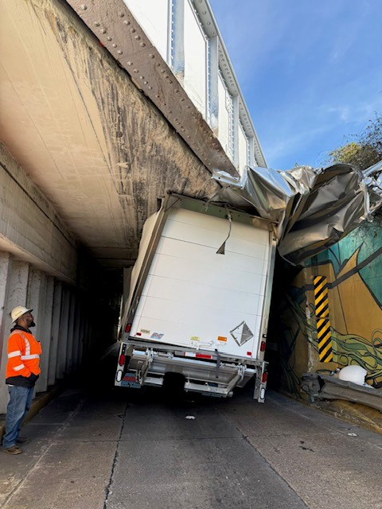
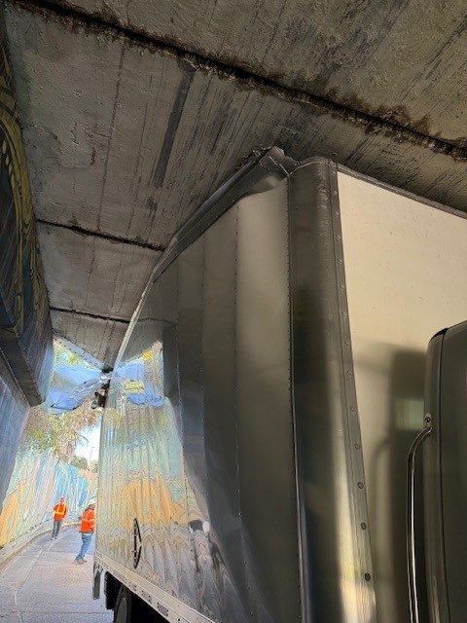
Property Damages
LSD – GOV struck concrete top of railroad overpass while attempting to drive underneath
$22,000.00

Slide 30
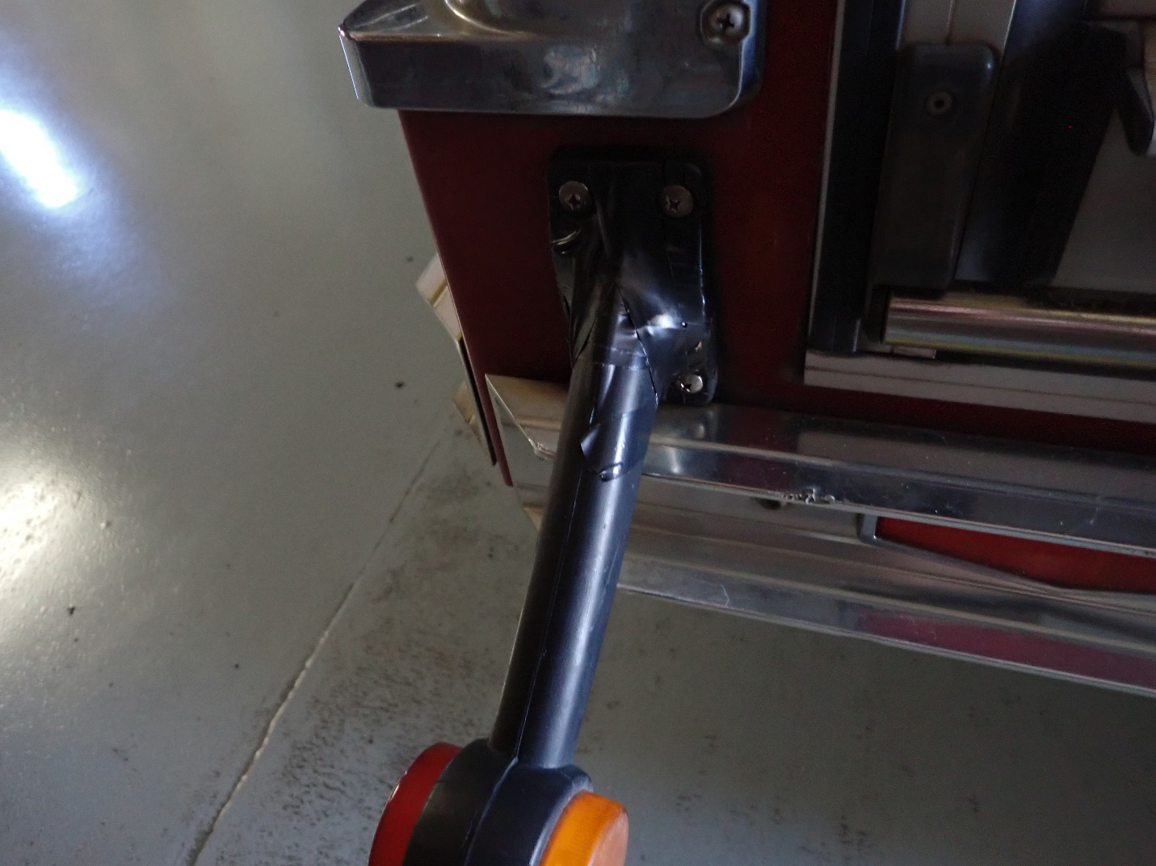
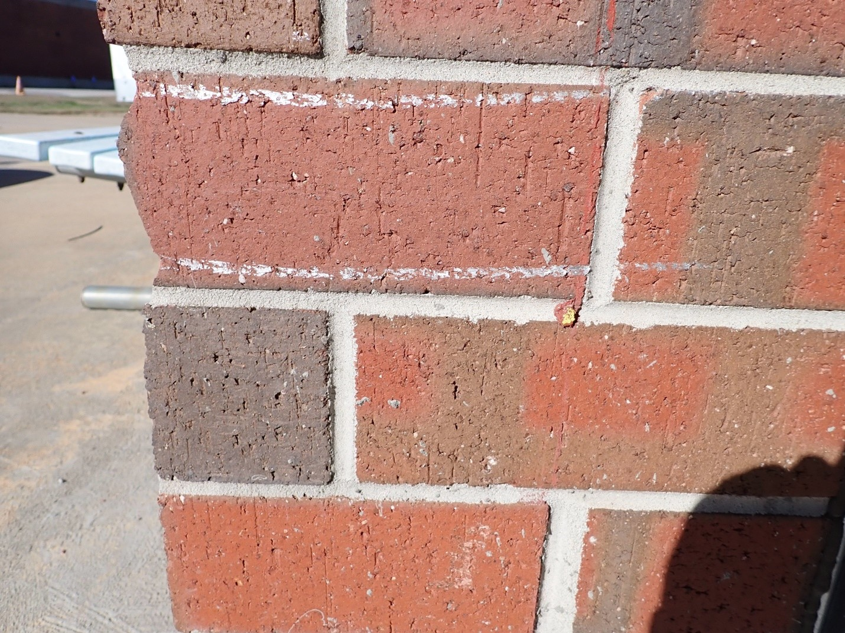
Property Damages
MCFD – GOV struck wall of bay door while attempting to back vehicle into bay
$100.00

Slide 31


CY25 Driver Education Program
Course | Alive at 25 | Attitudinal Dynamics of Driving (ADD)
Hours | 0730 -1200 | 0800-1500
Location | HRO, Bldg. 3010 | HRO, Bldg. 3010
Required For | Marines under age 26 | Drivers designated by the Base Traffic Court
Available For | Marine and Civilian Marine, family members ages 15-25 | Drivers designated by the Base Traffic Court
Dress/Uniform | Marines: Uniform of the day Civilians: Business casual | Marines: Uniform of the day Civilians: Business casual
Available Training | All dates are tentative based on number of enrollees. February 19, 2026 April 16, 2026 June 18, 2026 August 20, 2026 | The ADD course is taught as needed, minimum personnel required 10 students. The Base Traffic Court appoints required ADD course to on-base drivers who are convicted of a moving traffic violation.
1. Reference: MCLBAO 5100.19A dated 4 Dec 20 2. Reference: MCO 5100.29 C Alive At 25; Volume 3, Chapter 2, Para 021001 – All military personnel under the age of 26 will complete a traffic safety course. Marines under the age of 26 first gaining unit will ensure the Marines receive at least four hours of driver’s awareness training within 60 days of reporting to the Command. Training will include at least 30 minutes of local traffic familiarization. Attitudinal Dynamics of Driving (ADD); Volume 3, Chapter 2, Para 021002 – Anyone convicted of a moving traffic violation or who is found at-fault in a motor vehicle mishap while operating any GOV will attend a remedial driver training course. The remedial course will provide 6 to 8 hours of classroom instruction.
POC for all traffic training:
Whitney Hendrix @ (229) 639-7052

Slide 32
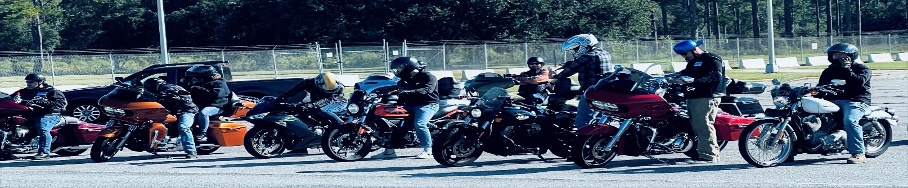
Motorcycle Training status as of 31 December 25
The MCLBA Motorcycle Mentorship Program (MMP) Dubber Dawgs hold monthly meetings. The meetings consist of gathering updated information from each rider, safety briefs, and discussing when and where for the next group ride. The next BRC in Blount Island Command is 23-24 March 2026. The next ARC is scheduled for 23 February 2026.
Albany Riders Club
Whitney Hendrix
Traffic Safety Program Manager
(229) 639-7052
Sgt Hunter Angevine
MCLBA MMP President
(229) 639-7489
Notes:
Alive @ 25 on Thursday, 24 June 21; 4 attendees completed instruction. (4 Marines)
Alive @ 25 on Saturday, 17 July 21; 13 attendees completed instruction, but on next quarter’s slides. (8 Civilian & 5 Marines)
ADD Course on Thursday, 22 July 21; 1 attendees completed instruction, but on next quarter’s slides (1 Civilian)
When gathering data, ensure we get total attendees, break down by Military or Civilian, and number of No-Shows.

Slide 33

MCFD – 1st Qtr. FY26
Prevention Section
FY-2026 | 1st QTR | YTD
Inspections | 112 | 112
Violations Found | 133 | 133
Violations Open | 77 | 77
Violations Corrected, Closed or Addressed | 56 | 56
Hot Work Permits Issued (HWPs) | 7 | 7
Top Violations 1st Quarter
Monthly Fire Extinguisher checks
Knox Box related
FACP in trouble
Deficiencies found during riser PM’s.
Open/Closed Violations Explained
Most open violations are items that have work orders in place, awaiting funding, bids, exceeds packages etc.
FY26 Changes
Revamped/Streamlined Inspection Schedule
Revamped training material
Revamped Fire Drill Schedule
RAC score transitioning to FSD score
Total Fire Wardens Trained for 1st QTR: 0 YTD: 0
Notes:
Double click graph to input data

Slide 34

MCPD – 4th Qtr. CY25
Reported Traffic Collisions
GOV
POV
VEHICLE TYPE | Quarter | YTD
GOV - GOV | 0 | 0
GOV - POV | 0 | 1
GOV - Fixed Object | 0 | 1
GOV - Animal | 0 | 0
GOV - Pedestrian | 0 | 0
GOV - Bicycle | 0 | 0
GOV - Rollover | 0 | 0
Hit & Run (GOV) | 0 | 0
Total | 0 | 2
VEHICLE TYPE | Quarter | YTD
POV - POV | 1 | 4
POV - GOV | 0 | 0
POV - Fixed Object | 1 | 9
POV - Animal | 2 | 3
Hit & Run (POV) | 0 | 0
POV - Bicycle | 0 | 0
POV - Rollover | 0 | 0
Motorcycle | 0 | 0
Total | 4 | 16
Reported “Motor Vehicle” Collisions (Off Road Damage to Property)
VEHICLE TYPE | Quarter | YTD
GOV - GOV | 0 | 0
GOV - POV | 0 | 1
GOV - Fixed Object | 1 | 13
Total | 1 | 14
VEHICLE TYPE | Quarter | YTD
POV - POV | 2 | 8
POV - GOV | 0 | 0
POV - Fixed Object | 0 | 0
Total | 2 | 8
34
Notes:
34
PMO

Slide 35

MCPD –4th Qtr. CY25
Notes:
35
Due to the furlough, there are no citations for Oct, Nov and Dec. (Citations written during those months were either changed to Warnings or moved to January traffic Court.

Slide 36
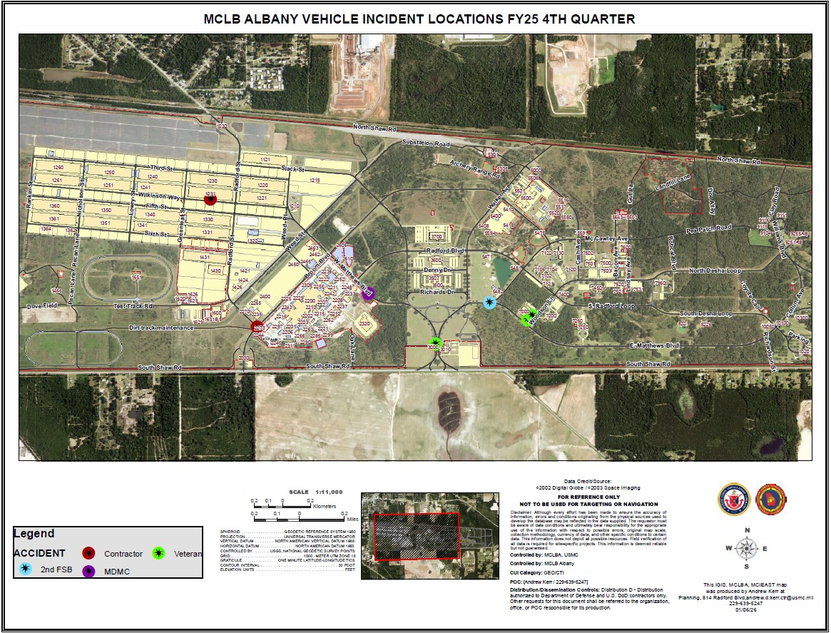

Slide 37

Injury Compensation
Federal Workers’ Compensation Program
Employees’ Compensation Operations & Management Portal (ECOMP) has become the preferred vehicle for processing new employee injury claims electronically.
All injuries should be reported using the electronic CA-1 or CA-2 forms which are within the ECOMP System
CA-1 and CA-2 forms should be processed by supervisors through the ECOMP System no later than 4 days following their employee’s injury as mandated by MPC-40.
Injury Status
Oct. | No injury reported.
Nov. | No injury reported.
Dec. | No injury reported.
Shelia Lester Florence Abria Johnson
Injury Compensation Program Administrator, Alternate DPC Primary Drug Program Coordinator
(229) 639-5244 (229) 639-5255

Slide 38
Annual Drug Testing Results (2021 thru 2026)

Slide 39


Radiation Safety Program
Activities:
05 Jan 26: Submitted RASP Command Annual Inventory to RASO.
Current inventory as of 30 Dec 25:
One (1) Telescope Elbow (MCSF-Blount Island Command).
Twenty-Five (25) Aiming Post Alignment Devices (LSD).
Forty-Seven (47) M67 Sight Mounts (General Accounts).
Johnny Little
Radiation Safety Manager
(229) 639-6721

Slide 40


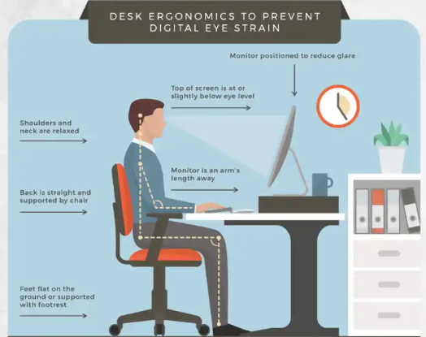

Ergonomics
FY26 Council Theme:
Workplace Risk Factors
Ergonomics and Digital Eye Strain
Digital eye strain, also know as computer vision syndrome, is a group of eye- and vision-related problems that result from prolonged use of digital screens. It can lead to symptoms such as blurred vision, headaches, dry eyes, neck or shoulder pain, and difficulty focusing. To prevent digital eye strain, it is essential to follow ergonomic guidelines and make simple adjustments.
Monitor Placement: Keep your screen 20-28 inches away.
Screen Brightness and Contrast: Adjust screen brightness to avoid glare and make it easier to read.
Blinking: Remember to blink more often, especially when using screens to keep your eyes moist and comfortable.
Blue Light Filters: Consider using blue light filters or anit-reflective coatings on your screen to reduce exposure to harmful blue light.
20-20-20 Rule: Every 20 minutes, look at something 20 feet away for 20 seconds to refresh your eyes.
Resource: University of Colorado
Whitney Hendrix
Ergonomics Program Manager
(229) 639-7052
ergonomics is the practice of fitting the workplace to the worker, not fitting the worker to the workplace. Ergonomics considers body dimensions, mobility, and the body’s stress behavior in the design of jobs, equipment, and work tasks

Slide 41

Explosives Safety
Explosive Safety Inspection (ESI) rescheduled for 6-10 Apr 26
Explosives Safety Officer
Rashode L. Best
(229) 639-6215

Slide 42
Hearing Conservation
Hearing Readiness Metrics CY25
(as of 26 Jan 26)
Reference: MCO 6260.3A, Marine Corps Hearing Conservation Program
Training requirements
Audiogram (Baseline, Annual, and Termination)
STS/PTS
Fit Testing
Identifying noise hazardous area and equipment
Best way to manage the military is by using MRRS
Alisha Montieth
Safety Specialist
639-7272
Notes:
Sir, we are briefing this slide , which was suggested by MCI as a way to provide the CO with a Hearing Readiness Status .
The Data on this side comes from ESAMS and MRRS
This slide covers the requirement for MCO 6260.3A, Marine Corps Hearing Conservation Program and the Readiness Metrics for CY20.
The Hearing Conservation Program’s requirements includes: Training, Audiogram, Significant Threshold Shift (STS) , Fit Testing , noise hazardous area and equipment inventory, etc.
Displayed on the chart, we have 192 personnel enrolled in the Hearing Conservation Program which are broken down by Department for CY20.
So far this calendar year, we currently have 151 audiogram that are in compliance.
We had No reported STS.
There are 6 termination audiogram reported and six baseline audiogram reported for the year.
Our Audiogram Compliance (AC) Rate is approximately 78%,.
The STS Rate is zero %.

Slide 43
MCLB Albany Medical Surveillance Program
(As of 26 Jan 26)
Total % Compliant: 92.1 (445/483)
MCLBA Compliant (90% or >)
Marine Corps Compliant (85% or >, but <90%)
Non-Compliant (<85%)
Occupational Health Program Manager
(229)639-7272

Slide 44

Naval Medicine Readiness Training Unit
Albany, GA
Industrial Hygiene Surveys
Branch/Division/Command | IH Assessment Date/Findings
MDMC PPA – OPS Div, Compliance Branch (CWC 130) | Completed Oct 2025 0 findings
MDMC PPA – Production Support Div (CWC 310 | Completed Oct 2025 0 findings
MDMC PPA – Materials Management Branch (CWC 110) | Completed Oct 2025 0 findings
MDMC PPA – Manufacturing Branch (CWC 240) | Completed Oct 2025 1 Findings Add housekeeping measures after lead/tin solder operations
DLA – Distribution Center | Completed Nov 2025 0 Findings
MDMC Respiratory Protection Review | Completed Nov 2025 2 Findings Personnel were not fully qualified and/or missing documentation Workplace-Specific RP Plans were outdated and/or incorrect data
MDMC PPA – Engineering Branch (CWC 120) | Completed Dec 2025 0 Findings
MDMC PPA – Engineering Equipment Branch (CWC 270) | Completed Dec 2025 0 Findings
LADONNA SCHEURER
INDUSTRIAL HYGIENIST
229-639-8458
JONATHAN RITTER
INDUSTRIAL HYGIENIST
229-639-6408

Slide 45
GREAT SAFETY TRAINING OPPORTUNITIES
What: | VPP 101 | Safety Leaders Workshop
Who: | New employees and Marines that have not previously attended the course. | New supervisors and managers that have not previously attended the course. Employees are encouraged to attend.
When: | 5 February 2026, 0900-1000 5 March 2026, 0900-1000 2 April 2026, 0900-1000 | 8-9 Jul 2026
Where: | Building 3500, Wing 500, Room 504 | I&E Training Room – Bldg. 5500
Why: | MCLB Albany is an OSHA VPP Star Site, this training will help new employees and Marines understand what VPP is and learn how they can help the Command maintain Star status. | To impart a stronger sense of awareness of safety issues to the workforce and increase employee’s understanding of the impact and importance of a robust and effective safety and health program.
How: | Please contact your division training coordinator to reserve your seat.
Supervisors needing Safety Leader’s Workshop
Name |  | Division | Name |  | Division | Name |  | Division
1 | Christopher Mercer | PSD | 7 |  |  | 13
2 | Col Matthew McKinney | Special Staff | 8 |  |  | 14
3 | Alejandro Nanez | PSD | 9 |  |  | 15
4 | Alejandro Nanez | PSD | 10 |  |  | 16
5 | Teddrick Parks | MCCS | 11
6 |  |  | 12
Notes:
Report pulled via ESAMS as to who needs the SLW forecasted out to 11/21/22.

Slide 46


Status of Formal Safety Training by Position
Unit | Name | Position | Trained | Course Schedule
HQ & Staff | Maj Barnard Sabin | Command Safety Officer | Yes | Ground Safety for Marines CY25 MCB CAMLEJ 2 – 13 Mar 26 1 – 12 Jun 26 14 – 25 Sep 26
HQ Company | SSgt Kevin Chapman | Company Safety Officer | 26 Jul 24
Comptroller | Ms. Seketitia Jackson | Safety Representative | 4 Jun 25
LSD | Mr. Shane Mcintyre | Safety Officer | 7 Mar 25
OTD | Mrs. Whitney Hendrix | Safety Technician | 26 Apr 24
CISD | Mrs. Tammy Sisai | Safety Officer | 18 Dec 15
I&E | Mr. Frederick Peoples | Safety Officer | 17 May 24
PSD | Mr. Manual Gray | Safety Officer | 05 Feb 16
 |  |  |  | Ground Mishap Investigation Course CY25 MCB CAMLEJ 20 – 24 Apr 26 14 – 18 Sep 26
MCCS | Robert Rachels | Safety Officer | 13 Mar 26
PPA | Mr. Joseph Carson | Safety Manager | Yes
SYSCOM | Vacant | Safety Officer
MFSC | Mr. Stacey Williams | Safety Manager | 17 Nov 20
DDAG | Vacant
General Accounts | Cpl Christopher Casilla | Safety Officer | 28 Oct 22
Marine Corps Safety Management System (MCSMS) 5100.29C, Chapter 5, Para 050302.C, dtd 15 Oct 20
Safety Officer Training: Commanders shall ensure that safety officers attend the Ground Safety For Marines Course (CIN# A-493-0047) within 90 days of assignment. ISMs will track and document training of all safety officers.

Slide 47



VPP ACTIVITIES
Completed for CY25
1. | OSHA VPP Self-Evaluation submitted on 4 Feb 25
2. | Three Risk Management personnel visited Cardinal for VPP mentorship on 8-10 April 25
3. | VPPPA 2025 Safety & Health Excellence Conference, Stone Mountain GA, 6-8 May 25 – Cancelled
4. | Two Risk Management personnel attended the VPPPA 2025 Safety Symposium, St. Louis, MO, on 11-14 August 25
Scheduled for CY26
1. | 2026 VPP Self-Evaluation for CY25 due on 1 May 26
Notes:
VPP Status Update..

Slide 48
CY25 Safety Award for 4th Quarter
CO’s Safety Division Quarterly/Yearly Award Criteria will be based on the Division that earns the Highest Total Points, which involve the Four Elements of VPP. The formula for calculating total points earned is as follows: VPPSC Participation + Near Miss Report + Hazard Abatement + Training.
Management Leadership & Employee Involvement
Worksite Analysis
Hazard Prevention & Control
Safety & Health Training
Table 1: VPPSC Participation
Ranking Order | Points Earned
If member(s) from your division attend all scheduled VPPSC Meeting(s), the impact could be as much as 30 points earned. The points earned are assessed below.
Absentee | Points Earned
0 | 30 Points
1 | 15 Points
2 | 5 Points
> 2 | 0 Points
100% Participation | 30 Points
Table 2: Near Miss Report
Ranking Order | Points Earned
1st | 10 Points
2nd | 9 Points
3rd | 8 Points
4th | 7 Points
5th | 6 Points
6th | 5 Points
7th | 4 Points
8th | 3 Points
No Near Miss Report | 0 Points
Table 3: Hazard Abatement
Ranking Order | Points Earned
1st | 25 Points
2nd | 23 Points
3rd | 21 Points
4th | 19 Points
5th | 17 Points
6th | 15 Points
7th | 13 Points
8th | 11 Points
100% Hazard Abatement | 30 Points
Table 4: Training
Ranking Order | Points Earned
1st | 25 Points
2nd | 20 Points
3rd | 18 Points
4th | 16 Points
5th | 14 Points
6th | 12 Points
7th | 10 Points
8th | 8 Points
100% Required Training | 30 Points
Notes:
1 The maximum number of points a division can receive is 100 points.
2 Risk Management will query near miss report and training records in ESAMS for the previous CY Quarter/Year.
3 Risk Management will calculate each division near miss rate and training completion rate and rank rates from highest to lowest.
4 Risk Management will query ESAMS and determine the Hazard Abatement for each division and rank order from highest to lowest.
5 Using Table 1, add your VPPSC Participation points earned to your running score.
6 Using Table 2, add points earned according to your division's Near Miss Report ranking order to your running score.
7 Using Table 3, add the Hazard Abatement points earned according to your division ranking to your running score.
8 Using Table 4, add the Training (ESAMS) points earned according to your division's Training Ranking order to your running score.
9 Risk Management will rank final scores of each division.
10 The division with the highest total points earned will be selected as the Safety Award Winner for the Quarter/Year.

Slide 49
CY25 Annual Safety Award
CO’s Safety Division Quarterly/Yearly Award Criteria will be based on the Division that earns the Highest Total Points, which involve the Four Elements of VPP. The formula for calculating total points earned is as follows: VPPSC Participation + Near Miss Report + Hazard Abatement + Training (ESAMS).
Management Leadership & Employee Involvement
Worksite Analysis
Hazard Prevention & Control
Safety & Health Training
Table 1: VPPSC Participation
Ranking Order | Points Earned
If member(s) from your division attend all scheduled VPPSC Meeting(s), the impact could be as much as 30 points earned. The points earned are assessed below.
Absentee | Points Earned
0 | 30 Points
1 | 15 Points
2 | 5 Points
> 2 | 0 Points
100% Participation | 30 Points
Table 2: Near Miss Report
Ranking Order | Points Earned
1st | 10 Points
2nd | 9 Points
3rd | 8 Points
4th | 7 Points
5th | 6 Points
6th | 5 Points
7th | 4 Points
8th | 3 Points
9th | 2 Points
No Near Miss Report | 0 Points
Table 3: Hazard Abatement
Ranking Order | Points Earned
1st | 25 Points
2nd | 23 Points
3rd | 21 Points
4th | 19 Points
5th | 17 Points
6th | 15 Points
7th | 13 Points
8th | 11 Points
9th | 9 Points
100% Hazard Abatement | 30 Points
Table 4: Training (ESAMS)
Ranking Order | Points Earned
1st | 25 Points
2nd | 20 Points
3rd | 18 Points
4th | 16 Points
5th | 14 Points
6th | 12 Points
7th | 10 Points
8th | 8 Points
9th | 6 Points
100% Required Training | 30 Points
Notes:
1 The maximum number of points a division can receive is 100 points.
2 Risk Management will query near miss report and training records in ESAMS for the previous CY Quarter/Year.
3 Risk Management will calculate each division near miss rate and training completion rate and rank rates from highest to lowest.
4 Risk Management will query ESAMS and determine the Hazard Abatement for each division and rank order from highest to lowest.
5 Using Table 1, add your VPPSC Participation points earned to your running score.
6 Using Table 2, add points earned according to your division's Near Miss Report ranking order to your running score.
7 Using Table 3, add the Hazard Abatement points earned according to your division ranking to your running score.
8 Using Table 4, add the Training (ESAMS) points earned according to your division's Training Ranking order to your running score.
9 Risk Management will rank final scores of each division.
10 The division with the highest total points earned will be selected as the Safety Award Winner for the Quarter/Year.

Slide 50

CO Guidance
Mark your Calendars
The next Safety Officer’s Council is:
29 Apr 26
The next Commanding Officer’s Safety Council is:
6 May 26

