Slide 1




Marine Corps Logistics Base Albany
Commanding Officer’s Quarterly Safety Council
FY25 3rd Quarter – 6 August 2025
PURPOSE
The purpose of the Safety Council is to review the installation and tenant safety performance and program effectiveness, to recommend changes to reduce unsafe practices and to strengthen the overall program.
(MCO 5100.29C Vol 1, Chap. 2, Para. 0204.F)
This meeting serves as the command:
Safe Driving Council (MCO 5100.29C, Vol 3, Chap. 7, Para. 0708.I)
Ergonomics Committee Meeting (NAVMC DIR 5100.8 Chap. 19, Para. 19003)
AGENDA
Goals
Performance Metrics
Inspections
Unit Safety Reports
GOV Fleet Safety
Traffic Safety
MCFD
MCPD
Base Traffic Court
Injury Compensation
RASP
Ergonomics
SACO
RODS
Explosive Safety
Hearing Conservation
Medical Surveillance
IH Surveys
Safety Training
VPP Activities
Safety Awards
Open Discussion
CO Guidance

Slide 2



Emergency Evacuation
Coffman Hall Evacuation Routes
Muster by the cannons
2

Slide 3

CY25 Command Safety Program Goal
MCLB Albany
GOAL: Reduce Life Safety Code Findings by 30%
Background: Risk Management has identified a significant increase in Life Safety Code findings, with a 23% surge in CY24 compared to CY23, accounting for over 20% of all safety findings in the past five years. Many of these hazards could have been identified and resolved by employees, highlighting a need for increased awareness and responsibility. This goal focuses on addressing these hazards by ensuring regular inspections of fire extinguishers, maintaining functional emergency/exit lights, and keeping fire exits clear. These actions aim to reduce safety risks, improve compliance, and foster a culture of safety, ultimately ensuring a safer and more efficient workplace while supporting our mission.
References: 29 CFR 1910 Subpart E and NFPA 101-2024 each require compliance with established fire safety standards to preserve the safety and health of employees and protect facilities.
Goal: Reduce Life Safety Code hazards by 30%, with no more than 25 findings total during CY25, as tracked in
Target Date: 30 June 2025
Goal Leader: Division Directors, Special Staff and HQ Company Commander
Goal Progress Reporting: Division Directors and HQ Company Commander will brief the progress of this goal at the Commanding Officer’s Quarterly Safety Council.
RMI-SIR
 | Objective | Objective Leader | Completion Date
1 | Division Directors will formally appoint Fire Wardens in writing for each work area, shop, or facility under their responsibility. | Division Directors, Special Staff and HQ Company Commander | 28 February 2025
2 | Division Directors will ensure fire wardens complete initial or refresher training through MCLBA’s Fire Prevention section, equipping them with the knowledge and skills necessary to conduct fire safety inspections effectively. | Division Directors, Special Staff and HQ Company Commander | 31 March 2025
3 | Division Directors will ensure 90% of the workforce completes the Fire Prevention and Portable Fire Extinguisher Training and Education (1024) module in ESAMS. | Division Directors, Special Staff and HQ Company Commander | 1 April 2025
4 | Division Directors will ensure that every employee participates in at least one documented safety and occupational health inspection of their work areas, with a specific focus on identifying Life Safety Code hazards such as uninspected fire extinguishers, non-working emergency/exit lights, and blocked fire exits. | Division Directors, Special Staff and HQ Company Commander | 30 June 2025
Assessment Criteria
No Action | In-Progress | Completed

Slide 4
Performance Metrics as of 30 Jun 25
CY21-CY25 Military RMI-SIR Cases
CY21-CY25 Civilian Lost Day Cases
6
2
Notes:
Military RMI-SIR Cases:
9/20/22 – SNM Bitten by an insect on the hand – No lost time
7/6/22 – SNM Playing PT soccer in gym. Marine stepped on foot and suffered fractured right foot -30 Days Light Duty
5/9/22 – SNM right hand struck while repairing motor assembly of POV. OFF Duty – 7 days light duty
3/12/22 – SNM left pinky finger on left hand was dislocated attempting to catch a football. OFF Duty – Splint 30 Days
3/17/21 – SNM struck bench at home and broke right hand. OFF Duty – 3 days Lost Time and 30-90 days Light Duty
3/22/21 – SNM hit back of head against a cabinet shelf left open. OFF Duty – 2 days Lost Time and 18 days Light Duty
5/18/21 – SNM rolled and sprained left ankle during personal PT. OFF Duty – 14 days Light Duty
5/24/21 – SNM smashed middle finger on left hand between kennel food bowl and wall. ON Duty – Splint 30 days
7/24/21 – SNM bitten by dog on right elbow. OFF Duty – Medication
Civilian Lost Day Cases:
9/6/22 – While performing a training exercise, employee was accidentally dropped onto the floor by another employee – 5 days Lost Time
8/10/22 – Employee fell and struck head while attempting to sit in office chair. 4 days Lost Time
3/29/21 – Employee struck in forehead with toy. 3 days Lost Time

Slide 5



OSHA Injury/Illness Rates
as of 30 Jun 25
OSHA RECORDABLE CASES
Calendar Year | # of Cases
2013 | 9
2014 | 9
2015 | 8
2016 | 8
2017 | 6
2018 | 5
2019 | 8
2020 | 5
2021 | 5
2022 | 5
2023 | 4
2024 | 2
2025 | 1
MCLB Albany Injury Rates (30 Jun 25)
MCLB Albany | CY13 | CY14 | CY15 | CY16 | CY17 | CY18 | CY19 | CY20 | CY21 | CY22 | CY23 | CY24 | CY25
DART | 1.0 | 0.5 | 0.7 | 0.5 | 0.4 | 0.5 | 0.2 | 0.8 | 0.6 | 0.4 | 0.7 | 0.9 | 0.0
TCIR | 2.4 | 1.5 | 1.5 | 1.5 | 1.5 | 1.1 | 0.9 | 1.4 | 0.9 | 1.0 | 0.9 | 0.9 | 0.5
NAICS | CY13 | CY14 | CY15 | CY16 | CY17 | CY18 | CY19 | CY20 | CY21 | CY22 | CY23 | CY24 | MCLB Albany 3-Year Average (CY21-CY23)
DART | 1.9 | 1.5 | 1.2 | 1.8 | 2.1 | 1.5 | 1.8 | 3.2 | 2.8 | 1.8 | 1.8 |  | 0.7
TCIR | 3.8 | 3.1 | 2.3 | 3.2 | 3.5 | 3.5 | 3.0 | 4.5 | 3.8 | 3.2 | 3.5 |  | 0.9
Notes:
CY22
1st Quarter
None
2nd Quarter
5/9/22 – SNM right hand struck while repairing motor assembly of POV. OFF Duty – 7 days light duty
3rd Quarter
8/10/22 – Employee fell and struck head while attempting to sit in office chair. 4 days Lost Time
9/6/22 – While performing a training exercise, employee was accidentally dropped onto the floor by another employee – 5 days Lost Time
4th Quarter

Slide 6


Inspections
FY25 – 3rd Qtr
CDC
I&E
LSD
DCMA
2nd Force Storage Battalion
Det 2 Supply
DDAG
General Accounts
MARCORSYSCOM

Slide 7
FY21 - FY25 Inspection Findings
(Includes All Organizations)
as of 30 Jun 25
Risk Assessment Code for all findings
 | FY 21 | FY 22 | FY 23 | FY 24 | FY 25
RAC 1 | 0 | 0 | 0 | 0 | 0
RAC 2 | 4 | 0 | 0 | 0 | 0
RAC 3 | 22 | 12 | 9 | 14 | 1
RAC 4 | 174 | 180 | 222 | 287 | 173
RAC 5 | 72 | 46 | 36 | 54 | 16
Total | 272 | 238 | 267 | 355 | 190
# of Findings
Notes:
This information includes data from the following inspections performed for FY22:
1st Qtr – 15 small tenants, I&E, and MCCS
2nd Qtr – PSD, HQ CO, Special Staff, OTD, Comptroller, Manpower, CISD, MCCS, PPA, and PowerWorks.
3rd Qtr – LSD, MFSC, and DLA; pending CDC, and I&E.
4th Qtr –
This information includes data from the following inspections performed in FY23
1st Quarter – CDC, I&E, LSD, MARCORLOGCOM, 15 Small Tenants

Slide 8
FY21 - FY25 Inspection Findings
MCLB Albany
as of 30 Jun 25
Risk Assessment Code for all findings
 | FY 21 | FY 22 | FY 23 | FY 24 | FY 25
RAC 1 | 0 | 0 | 0 | 0 | 0
RAC 2 | 4 | 0 | 0 | 0 | 0
RAC 3 | 16 | 2 | 7 | 11 | 0
RAC 4 | 75 | 73 | 110 | 75 | 67
RAC 5 | 73 | 43 | 22 | 60 | 15
Total | 168 | 118 | 139 | 146 | 82
# of Findings
Notes:
This information includes data from the following inspections performed for FY22:
1st Qtr - I&E and MCCS
2nd Qtr – PSD, HQ CO, Special Staff, OTD, Comptroller, Manpower, CISD, and MCCS.
3rd Qtr – DDAG, LSD, CDC (quarterly), I&E
4th Qtr - …

Slide 9
Safety and Occupational Health Inspections
FY23 Abatement Efficiency Index: 99%
1% or (1) of the (267) Findings identified by Safety & Occupational Health Inspections during FY23 were not documented as abated within 30 days.
Supervisor Responsibility: “Provide for or ensure abatement of all identified workplace OSH deficiencies.” NAVMC Dir 5100.8, Chap. 7 Para 7004.4.f
Open Findings as of 30 Jun 25
UNIT | Number | RAC
I&E | 1 | 3
Total | 1
The Unit Safety Officer is responsible for maintaining a hazard abatement log, monitoring the corrective actions (Work Requests) taken, and reporting the status to the Risk Management Office.
Notes:
24 of the 161 findings for FY22 are still open as of 27 Apr 22, which gives us an 83% Abatement Efficiency index.
1st Qtr data input - 15 small tenants, I&E, and MCCS
2nd Qtr data input - PSD, HQ CO, Special Staff, OTD, Comptroller, Manpower, CISD, MCCS, PPA, and PowerWorks.
3rd Qtr data input - includes LSD, MFSC, and DLA data, CDC and I&E.
4th Qtr data input -

Slide 10
Safety and Occupational Health Inspections
FY24 Abatement Efficiency Index: 98%
2% or (6) of the (355) Findings identified by Safety & Occupational Health Inspections during FY24 are not documented as abated within 30 days.
Supervisor Responsibility: “Provide for or ensure abatement of all identified workplace OSH deficiencies.” NAVMC Dir 5100.8, Chap. 7 Para 7004.4.f
Open Findings as of 30 Jun 25
UNIT | Number | RAC
PSD | 3 | 4
DECA | 1 | 4
General Accounts | 2 | 4
Total | 6
The Unit Safety Officer is responsible for maintaining a hazard abatement log, monitoring the corrective actions (Work Requests) taken, and reporting the status to the Risk Management Office.
Notes:
24 of the 161 findings for FY22 are still open as of 27 Apr 22, which gives us an 83% Abatement Efficiency index.
1st Qtr data input - 15 small tenants, I&E, and MCCS
2nd Qtr data input - PSD, HQ CO, Special Staff, OTD, Comptroller, Manpower, CISD, MCCS, PPA, and PowerWorks.
3rd Qtr data input - includes LSD, MFSC, and DLA data, CDC and I&E.
4th Qtr data input -

Slide 11
Safety and Occupational Health Inspections
FY25 Abatement Efficiency Index:85%
14% or (28) of the (190) Findings identified by Safety & Occupational Health Inspections during FY25 are not documented as abated within 30 days.
Supervisor Responsibility: “Provide for or ensure abatement of all identified workplace OSH deficiencies.” NAVMC Dir 5100.8, Chap. 7 Para 7004.4.f
Open Findings as of 30 Jun 25
UNIT | Number | RAC
LSD | 1 | 4
2nd Force Storage Btn | 10 | 3/4
DLA | 8 | 4
Ga National Guard | 6 | 4
PHA | 3 | 4
Total | 28
The Unit Safety Officer is responsible for maintaining a hazard abatement log, monitoring the corrective actions (Work Requests) taken, and reporting the status to the Risk Management Office.
Notes:
24 of the 161 findings for FY22 are still open as of 27 Apr 22, which gives us an 83% Abatement Efficiency index.
1st Qtr data input - 15 small tenants, I&E, and MCCS
2nd Qtr data input - PSD, HQ CO, Special Staff, OTD, Comptroller, Manpower, CISD, MCCS, PPA, and PowerWorks.
3rd Qtr data input - includes LSD, MFSC, and DLA data, CDC and I&E.
4th Qtr data input -

Slide 12
Report of Near Miss
Risk Management received 1 valid Near Miss* Report for this quarter
*A Near Miss is defined as: Conditions that exist or incidents that occur without injury or property damage. Near misses include unsafe or unhealthful actions, behaviors, or working conditions that did not result in a mishap. (MCLBAO P5100.1M)
2nd Quarter CY25
Stacey Williams
Safety Specialist/Program Manager
639-7049
Notes:
This is a summary of the near miss reports submitted for the 2nd quarter for the Calendar Year.
We had a total of 2 valid Near Miss reports submitted during the 2nd quarter.
Slips, Trips and Fall is leading in the trends of near miss reported followed by other incidents.
A break down of near miss reports are shown by Divisions.

Slide 13
Unit Safety Reports
Briefing Order:
H&S Company
OTD
Manpower
Comptroller
LSD
CISD
I&E
PSD
MCCS
DLA
Notes:
Units with a reported mishap or injuries will brief their information.
Brief by exception. Slides are hidden, but we maintain the data.

Slide 14



Headquarters Company
 | Objective | Objective Leader | Completion Date
1 | Division Directors will formally appoint Fire Wardens in writing for each work area, shop, or facility under their responsibility. | Division Directors, Special Staff and HQ Company Commander | 28 February 2025
2 | Division Directors will ensure fire wardens complete initial or refresher training through MCLBA’s Fire Prevention section, equipping them with the knowledge and skills necessary to conduct fire safety inspections effectively. | Division Directors, Special Staff and HQ Company Commander | 31 March 2025
3 | Division Directors will ensure 90% of the workforce completes the Fire Prevention and Portable Fire Extinguisher Training and Education (1024) module in ESAMS. | Division Directors, Special Staff and HQ Company Commander | 1 April 2025
4 | Division Directors will ensure that every employee participates in at least one documented safety and occupational health inspection of their work areas, with a specific focus on identifying Life Safety Code hazards such as uninspected fire extinguishers, non-working emergency/exit lights, and blocked fire exits. | Division Directors, Special Staff and HQ Company Commander | 30 June 2025
NO ACTION IN PROGRESS COMPLETED
Notes:
Quadrant 1-Injury / rate chart- no change-fill in data sheet and display the chart.
Quadrant 2-OSHA Data. We have filled in the previous data. Put in your current information. Near miss will include any from your personnel we have AND any you have received that we did not.
Quadrant 3 Property damage. List any you have had. Previous quarters should be up-to-date. We want cumulative for the CY.
Quadrant 4

Slide 15
Narrative of Military RMI-SIR Cases CY25
 | Date | Narrative | Status | Results
1st Qtr. |  | NONE
2nd Qtr. |  | NONE
3rd Qtr.
4th Qtr.
On duty
Off duty
Lost time
Restriction
Other
First Aid

Slide 16



Operations and Training Division
 | Objective | Objective Leader | Completion Date
1 | Division Directors will formally appoint Fire Wardens in writing for each work area, shop, or facility under their responsibility. | Division Directors, Special Staff and HQ Company Commander | 28 February 2025
2 | Division Directors will ensure fire wardens complete initial or refresher training through MCLBA’s Fire Prevention section, equipping them with the knowledge and skills necessary to conduct fire safety inspections effectively. | Division Directors, Special Staff and HQ Company Commander | 31 March 2025
3 | Division Directors will ensure 90% of the workforce completes the Fire Prevention and Portable Fire Extinguisher Training and Education (1024) module in ESAMS. | Division Directors, Special Staff and HQ Company Commander | 1 April 2025
4 | Division Directors will ensure that every employee participates in at least one documented safety and occupational health inspection of their work areas, with a specific focus on identifying Life Safety Code hazards such as uninspected fire extinguishers, non-working emergency/exit lights, and blocked fire exits. | Division Directors, Special Staff and HQ Company Commander | 30 June 2025
NO ACTION IN PROGRESS COMPLETED
Notes:
Base ops and civilian training, PAO, Mission assurance branch
Quadrant 1-Injury / rate chart- no change-fill in data sheet and display the chart.
Quadrant 2-OSHA Data. We have filled in the previous data. Put in your current information. Near miss will include any from your personnel we have AND any you have received that we did not.
Quadrant 3 Property damage. List any you have had. Previous quarters should be up-to-date. We want cumulative for the CY.
Quadrant 4 Progress toward Command Safety Goals. Each goal has several objectives. The objective status box will be red, yellow or green depending upon your unit progress toward the objective. If you have done nothing yet, the box is red. If you are working on it, the box is yellow. You can enter a % complete in the box. If all is complete, the box is green. The far right box is progress on the complete goal. Red if no progress, yellow if working but not all objectives are complete, Green when all is complete.

Slide 17



Manpower
 | Objective | Objective Leader | Completion Date
1 | Division Directors will formally appoint Fire Wardens in writing for each work area, shop, or facility under their responsibility. | Division Directors, Special Staff and HQ Company Commander | 28 February 2025
2 | Division Directors will ensure fire wardens complete initial or refresher training through MCLBA’s Fire Prevention section, equipping them with the knowledge and skills necessary to conduct fire safety inspections effectively. | Division Directors, Special Staff and HQ Company Commander | 31 March 2025
3 | Division Directors will ensure 90% of the workforce completes the Fire Prevention and Portable Fire Extinguisher Training and Education (1024) module in ESAMS. | Division Directors, Special Staff and HQ Company Commander | 1 April 2025
4 | Division Directors will ensure that every employee participates in at least one documented safety and occupational health inspection of their work areas, with a specific focus on identifying Life Safety Code hazards such as uninspected fire extinguishers, non-working emergency/exit lights, and blocked fire exits. | Division Directors, Special Staff and HQ Company Commander | 30 June 2025
NO ACTION IN PROGRESS COMPLETED
Notes:
July: Employee sustained injuries to the lower back and right leg when they fell over industrial fan.
August:
1) LOST TIME: Employee sustained a broken left foot then they lost their footing and fell down a set of stairs.
2) Employee sustained a laceration to the finger due to a Military working dog bite.

Slide 18



Office of the Comptroller
 | Objective | Objective Leader | Completion Date
1 | Division Directors will formally appoint Fire Wardens in writing for each work area, shop, or facility under their responsibility. | Division Directors, Special Staff and HQ Company Commander | 28 February 2025
2 | Division Directors will ensure fire wardens complete initial or refresher training through MCLBA’s Fire Prevention section, equipping them with the knowledge and skills necessary to conduct fire safety inspections effectively. | Division Directors, Special Staff and HQ Company Commander | 31 March 2025
3 | Division Directors will ensure 90% of the workforce completes the Fire Prevention and Portable Fire Extinguisher Training and Education (1024) module in ESAMS. | Division Directors, Special Staff and HQ Company Commander | 1 April 2025
4 | Division Directors will ensure that every employee participates in at least one documented safety and occupational health inspection of their work areas, with a specific focus on identifying Life Safety Code hazards such as uninspected fire extinguishers, non-working emergency/exit lights, and blocked fire exits. | Division Directors, Special Staff and HQ Company Commander | 30 June 2025
NO ACTION IN PROGRESS COMPLETED

Slide 19
Logistics Support Division
 | Objective | Objective Leader | Completion Date
1 | Division Directors will formally appoint Fire Wardens in writing for each work area, shop, or facility under their responsibility. | Division Directors, Special Staff and HQ Company Commander | 28 February 2025
2 | Division Directors will ensure fire wardens complete initial or refresher training through MCLBA’s Fire Prevention section, equipping them with the knowledge and skills necessary to conduct fire safety inspections effectively. | Division Directors, Special Staff and HQ Company Commander | 31 March 2025
3 | Division Directors will ensure 90% of the workforce completes the Fire Prevention and Portable Fire Extinguisher Training and Education (1024) module in ESAMS. | Division Directors, Special Staff and HQ Company Commander | 1 April 2025
4 | Division Directors will ensure that every employee participates in at least one documented safety and occupational health inspection of their work areas, with a specific focus on identifying Life Safety Code hazards such as uninspected fire extinguishers, non-working emergency/exit lights, and blocked fire exits. | Division Directors, Special Staff and HQ Company Commander | 30 June 2025
NO ACTION IN PROGRESS COMPLETED

Slide 20



Installation & Environment Division
 | Objective | Objective Leader | Completion Date
1 | Division Directors will formally appoint Fire Wardens in writing for each work area, shop, or facility under their responsibility. | Division Directors, Special Staff and HQ Company Commander | 28 February 2025
2 | Division Directors will ensure fire wardens complete initial or refresher training through MCLBA’s Fire Prevention section, equipping them with the knowledge and skills necessary to conduct fire safety inspections effectively. | Division Directors, Special Staff and HQ Company Commander | 31 March 2025
3 | Division Directors will ensure 90% of the workforce completes the Fire Prevention and Portable Fire Extinguisher Training and Education (1024) module in ESAMS. | Division Directors, Special Staff and HQ Company Commander | 1 April 2025
4 | Division Directors will ensure that every employee participates in at least one documented safety and occupational health inspection of their work areas, with a specific focus on identifying Life Safety Code hazards such as uninspected fire extinguishers, non-working emergency/exit lights, and blocked fire exits. | Division Directors, Special Staff and HQ Company Commander | 30 June 2025
NO ACTION IN PROGRESS COMPLETED
Notes:
Quadrant 1-Injury / rate chart- no change-fill in data sheet and display the chart.
Quadrant 2-OSHA Data. We have filled in the previous data. Put in your current information. Near miss will include any from your personnel we have AND any you have received that we did not.
Quadrant 3 Property damage. List any you have had. Previous quarters should be up-to-date. We want cumulative for the CY.
Quadrant 4

Slide 21

Public Safety Division
 | Objective | Objective Leader | Completion Date
1 | Division Directors will formally appoint Fire Wardens in writing for each work area, shop, or facility under their responsibility. | Division Directors, Special Staff and HQ Company Commander | 28 February 2025
2 | Division Directors will ensure fire wardens complete initial or refresher training through MCLBA’s Fire Prevention section, equipping them with the knowledge and skills necessary to conduct fire safety inspections effectively. | Division Directors, Special Staff and HQ Company Commander | 31 March 2025
3 | Division Directors will ensure 90% of the workforce completes the Fire Prevention and Portable Fire Extinguisher Training and Education (1024) module in ESAMS. | Division Directors, Special Staff and HQ Company Commander | 1 April 2025
4 | Division Directors will ensure that every employee participates in at least one documented safety and occupational health inspection of their work areas, with a specific focus on identifying Life Safety Code hazards such as uninspected fire extinguishers, non-working emergency/exit lights, and blocked fire exits. | Division Directors, Special Staff and HQ Company Commander | 30 June 2025
NO ACTION IN PROGRESS COMPLETED

Slide 22
Communications and Information Systems Division
 | Objective | Objective Leader | Completion Date
1 | Division Directors will formally appoint Fire Wardens in writing for each work area, shop, or facility under their responsibility. | Division Directors, Special Staff and HQ Company Commander | 28 February 2025
2 | Division Directors will ensure fire wardens complete initial or refresher training through MCLBA’s Fire Prevention section, equipping them with the knowledge and skills necessary to conduct fire safety inspections effectively. | Division Directors, Special Staff and HQ Company Commander | 31 March 2025
3 | Division Directors will ensure 90% of the workforce completes the Fire Prevention and Portable Fire Extinguisher Training and Education (1024) module in ESAMS. | Division Directors, Special Staff and HQ Company Commander | 1 April 2025
4 | Division Directors will ensure that every employee participates in at least one documented safety and occupational health inspection of their work areas, with a specific focus on identifying Life Safety Code hazards such as uninspected fire extinguishers, non-working emergency/exit lights, and blocked fire exits. | Division Directors, Special Staff and HQ Company Commander | 30 June 2025
NO ACTION IN PROGRESS COMPLETED
Notes:
July: Employee sustained injuries to the lower back and right leg when they fell over industrial fan.
August:
1) LOST TIME: Employee sustained a broken left foot then they lost their footing and fell down a set of stairs.
2) Employee sustained a laceration to the finger due to a Military working dog bite.

Slide 23


Marine Corps Community Services
 | Objective | Objective Leader | Completion Date
1 | Division Directors will formally appoint Fire Wardens in writing for each work area, shop, or facility under their responsibility. | Division Directors, Special Staff and HQ Company Commander | 28 February 2025
2 | Division Directors will ensure fire wardens complete initial or refresher training through MCLBA’s Fire Prevention section, equipping them with the knowledge and skills necessary to conduct fire safety inspections effectively. | Division Directors, Special Staff and HQ Company Commander | 31 March 2025
3 | Division Directors will ensure 90% of the workforce completes the Fire Prevention and Portable Fire Extinguisher Training and Education (1024) module in ESAMS. | Division Directors, Special Staff and HQ Company Commander | 1 April 2025
4 | Division Directors will ensure that every employee participates in at least one documented safety and occupational health inspection of their work areas, with a specific focus on identifying Life Safety Code hazards such as uninspected fire extinguishers, non-working emergency/exit lights, and blocked fire exits. | Division Directors, Special Staff and HQ Company Commander | 30 June 2025
NO ACTION IN PROGRESS COMPLETED
Notes:
Quadrant 1-Injury / rate chart- no change-fill in data sheet and display the chart.
Quadrant 2-OSHA Data. We have filled in the previous data. Put in your current information. Near miss will include any from your personnel we have AND any you have received that we did not.
Quadrant 3 Property damage. List any you have had. Previous quarters should be up-to-date. We want cumulative for the CY.
Quadrant 4 Progress toward Command Safety Goals. Each goal has several objectives. The objective status box will be red, yellow or green depending upon your unit progress toward the objective. If you have done nothing yet, the box is red. If you are working on it, the box is yellow. You can enter a % complete in the box. If all is complete, the box is green. The far right box is progress on the complete goal. Red if no progress, yellow if working but not all objectives are complete, Green when all is complete.

Slide 24

DLA Distribution Albany Georgia
Successes, Initiatives, and Concerns
DLA Distribution Albany: Planned fire drills were successfully conducted in coordination with the fire department to evaluate and reinforce emergency preparedness procedures across the facility. Spill response training was delivered to employees to improve awareness and readiness in the event of a hazardous material release. Continued focus on strengthening emergency response capabilities through hands-on training and real-time evacuation drills. Continuously encouraging continued focus on safety improvements and invite suggestions for future initiatives.
Notes:
24
24
Quadrant 1-Injury / rate chart- no change-fill in data sheet and display the chart.
Quadrant 2-OSHA Data. We have filled in the previous data. Put in your current information. Near miss will include any from your personnel we have AND any you have received that we did not.
Quadrant 3 Property damage. List any you have had. Previous quarters should be up-to-date. We want cumulative for the CY.
Quadrant 4 Successes etc. This is for you to put in and blow your horn. Share with us. If you have a problem or concern, share, it.

Slide 25
GOV Fleet Safety
GOV Damage
Ms. Kelly Eadie
Director, LSD
(229) 639-6733
Notes:
GOV damage values only. Ensure no other non-GOV property damages are added on this chart.
Note on lowest and highest quarters.

Slide 26
FY25 GOV and Real Property Damage Cases
Quarter | Date | Narrative | Cost
1st Qtr | 5 Nov 24 | PSD – GOV struck pole while backing into parking space | $5447.00
 | 16 Dec 24 | LSD – GOV struck electric cord reel while backing up, causing damage to passenger side mirror | $100.00
2nd Qtr | 19 Mar 25 | PSD – GOV struck pole while backing into parking space | $100.00
3rd Qtr | 23 Jun 25 | MCFD – GOV struck concrete barrier while backing into parking space | $100.00
Total |  | 4 Property Damages | $5747.00
Total reimbursable: $0
Notes:
Difference between the total on this slide and GOV Damage is that this slide includes other incidents of property damages.
1st Qtr - $3000 Light pole in collision
2nd Qtr - $2400 POV damaged wall at Auto-Hobby Shop. Covered by POV insurance.
3rd Qtr - $550 Shattered rear e-cart window covered by contractor.
4th Qtr - $438 Damage to front axle on trailer from striking a protective barrier

Slide 27
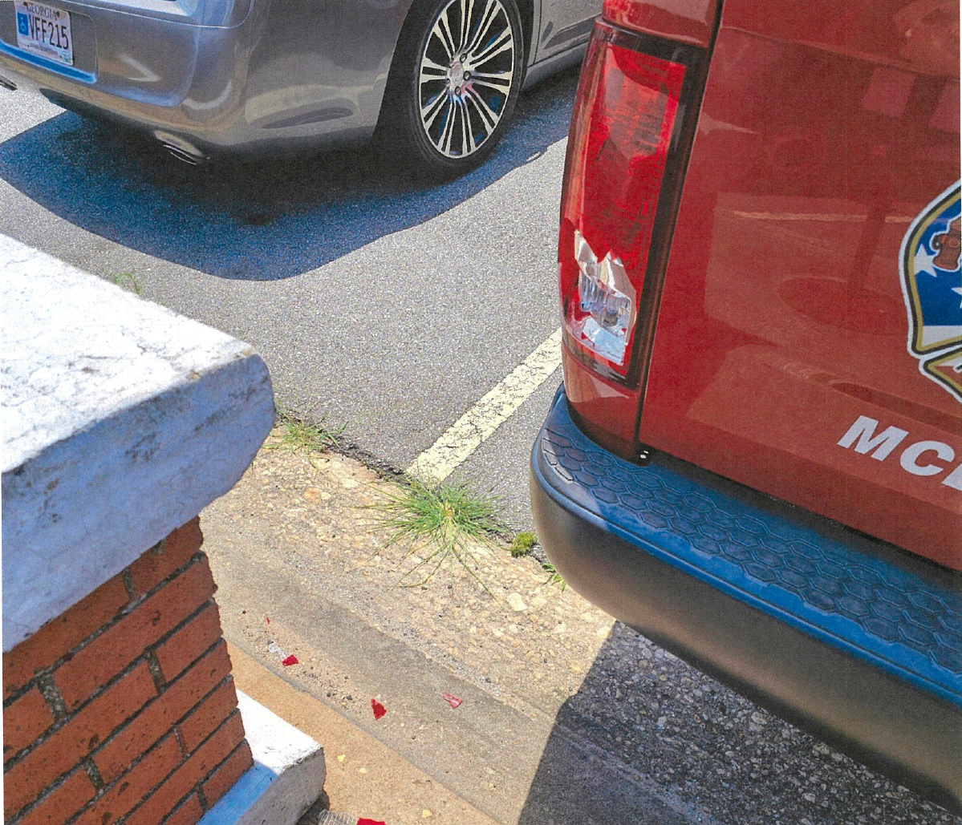
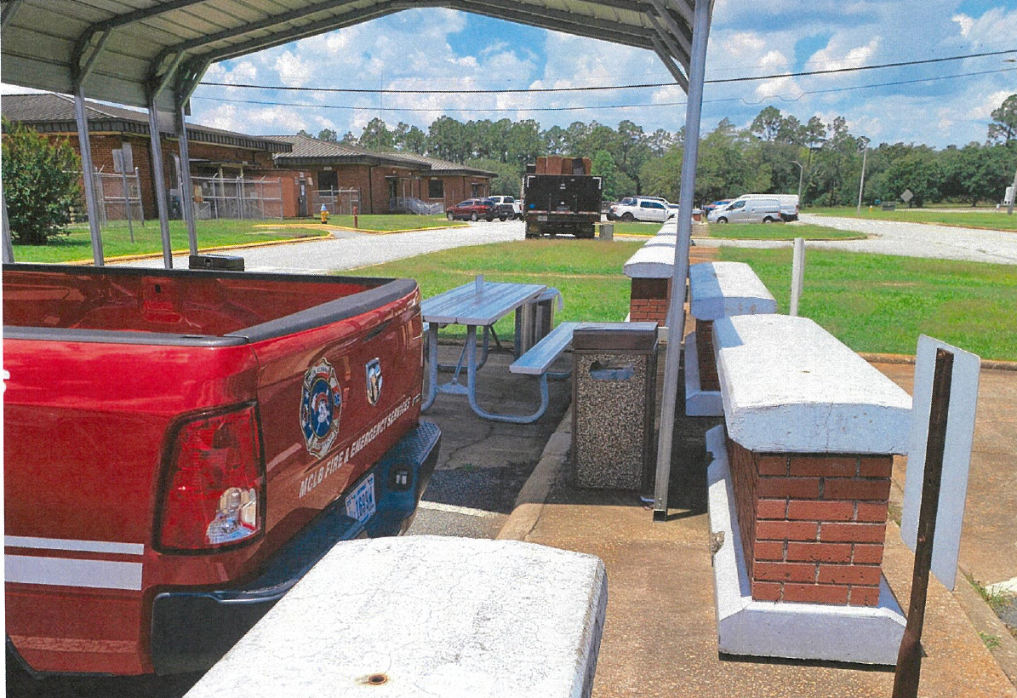

Property Damages
MCFD – GOV struck concrete barrier while backing into parking space
$100.00

Slide 28


Driver Education Program
CY25
Course | Alive at 25 | Attitudinal Dynamics of Driving (ADD)
Hours | 0730 -1200 | 0800-1500
Location | HRO, Bldg. 3010 | HRO, Bldg. 3010
Required For | Marines under age 26 | Drivers designated by the Base Traffic Court
Available For | Marine and Civilian Marine, family members ages 15-25 | Drivers designated by the Base Traffic Court
Dress/Uniform | Marines: Uniform of the day Civilians: Business casual | Marines: Uniform of the day Civilians: Business casual
Available Training | All dates are tentative based on number of enrollees. Thursday, 18 Sep 25 Thursday, 20 Nov 25 | The ADD course is taught as needed, minimum personnel required 10 students. The Base Traffic Court appoints required ADD course to on-base drivers who are convicted of a moving traffic violation.
1. Reference: MCLBAO 5100.19A dated 4 Dec 20 2. Reference: MCO 5100.29 C Alive At 25; Volume 3, Chapter 2, Para 021001 – All military personnel under the age of 26 will complete a traffic safety course. Marines under the age of 26 first gaining unit will ensure the Marines receive at least four hours of driver’s awareness training within 60 days of reporting to the Command. Training will include at least 30 minutes of local traffic familiarization. Attitudinal Dynamics of Driving (ADD); Volume 3, Chapter 2, Para 021002 – Anyone convicted of a moving traffic violation or who is found at-fault in a motor vehicle mishap while operating any GOV will attend a remedial driver training course. The remedial course will provide 6 to 8 hours of classroom instruction.
POC for all traffic training:
Whitney Hendrix @ (229) 639-7052

Slide 29
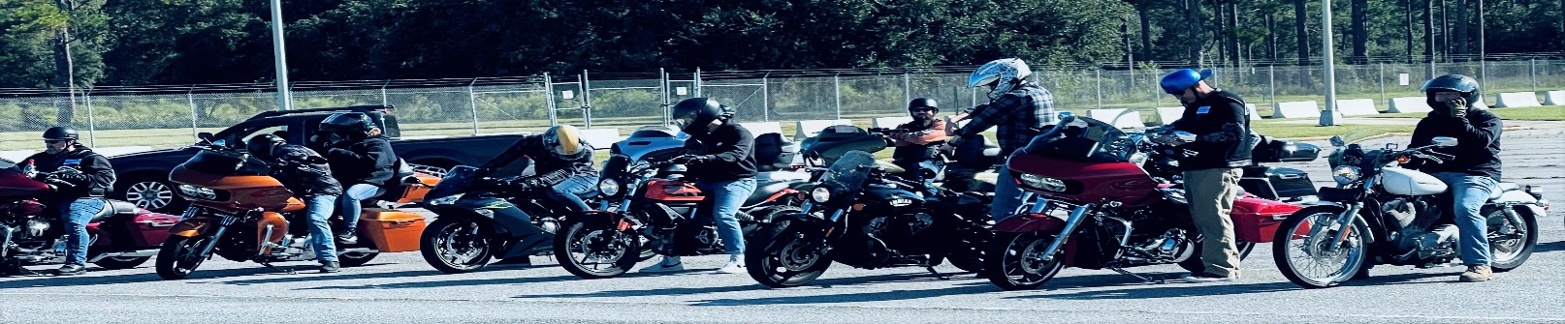
Motorcycle Training status as of 30 June 25
The MCLBA Motorcycle Mentorship Program (MMP) Dubber Dawgs held a monthly meeting in June planning a club ride in August, also Sgt Hunter Angevine is the new MMP President. The Command has 6 active riders, and 12 inactive riders as reported in the MMP meeting in June. Six Marines scheduled BRC at Blount Island Command 22-23 September. Next ARC is scheduled for 26 September 2025.
Albany Riders Club
Whitney Hendrix
Traffic Safety Program Manager
(229) 639-7052
Sgt Hunter Angevine
MCLBA MMP President
(229) 639-7489
Notes:
Alive @ 25 on Thursday, 24 June 21; 4 attendees completed instruction. (4 Marines)
Alive @ 25 on Saturday, 17 July 21; 13 attendees completed instruction, but on next quarter’s slides. (8 Civilian & 5 Marines)
ADD Course on Thursday, 22 July 21; 1 attendees completed instruction, but on next quarter’s slides (1 Civilian)
When gathering data, ensure we get total attendees, break down by Military or Civilian, and number of No-Shows.

Slide 30

MCFD – 3rd Qtr. FY25
Prevention Section
FY-2025 | 3rd QTR | YTD
Inspections | 130 | 320
Violations Open | 52 | 145
Violations Closed | 54 | 146
On the Spot Corrections (OSCs) | 6 | 11
Hot Work Permits Issued (HWPs) | 6 | 28
Per MCLBAO 11320.2G, Directors and Branch Heads are appointed Area Fire Marshals & are responsible for the Fire Prevention programs in their areas of responsibility.
Branch Heads appoint in writing a Fire Warden who will be responsible for executing and implementing the fire prevention program within their building, facility or areas.
Appointment letters shall be sent to the Fire Prevention Chief Charles Thurmond at:
charles.thurmond@usmc.mil
Each tenant within a facility shall have a Fire Warden assigned.
Total Fire Wardens Trained for 3rd QTR: 10 YTD: 135
Notes:
Double click graph to input data

Slide 31

MCPD – 2nd Qtr. CY25
Reported Traffic Collisions
GOV
POV
VEHICLE TYPE | Quarter | YTD
GOV - GOV | 0 | 0
GOV - POV | 1 | 1
GOV - Fixed Object | 1 | 1
GOV - Animal | 0 | 0
GOV - Pedestrian | 0 | 0
GOV - Bicycle | 0 | 0
GOV - Rollover | 0 | 0
Hit & Run (GOV) | 0 | 0
Total | 2 | 2
VEHICLE TYPE | Quarter | YTD
POV - POV | 1 | 1
POV - GOV | 0 | 0
POV - Fixed Object | 8 | 8
POV - Animal | 0 | 0
Hit & Run (POV) | 0 | 0
POV - Bicycle | 0 | 0
POV - Rollover | 0 | 0
Motorcycle | 0 | 0
Total | 9 | 9
Reported “Motor Vehicle” Collisions (Off Road Damage to Property)
VEHICLE TYPE | Quarter | YTD
GOV - GOV | 0 | 0
GOV - POV | 0 | 0
GOV - Fixed Object | 2 | 4
Total | 2 | 4
VEHICLE TYPE | Quarter | YTD
POV - POV | 2 | 4
POV - GOV | 0 | 0
POV - Fixed Object | 1 | 0
Total | 3 | 5
34
Notes:
31
PMO

Slide 32

MCPD –2nd Qtr. CY25
Notes:
32

Slide 33
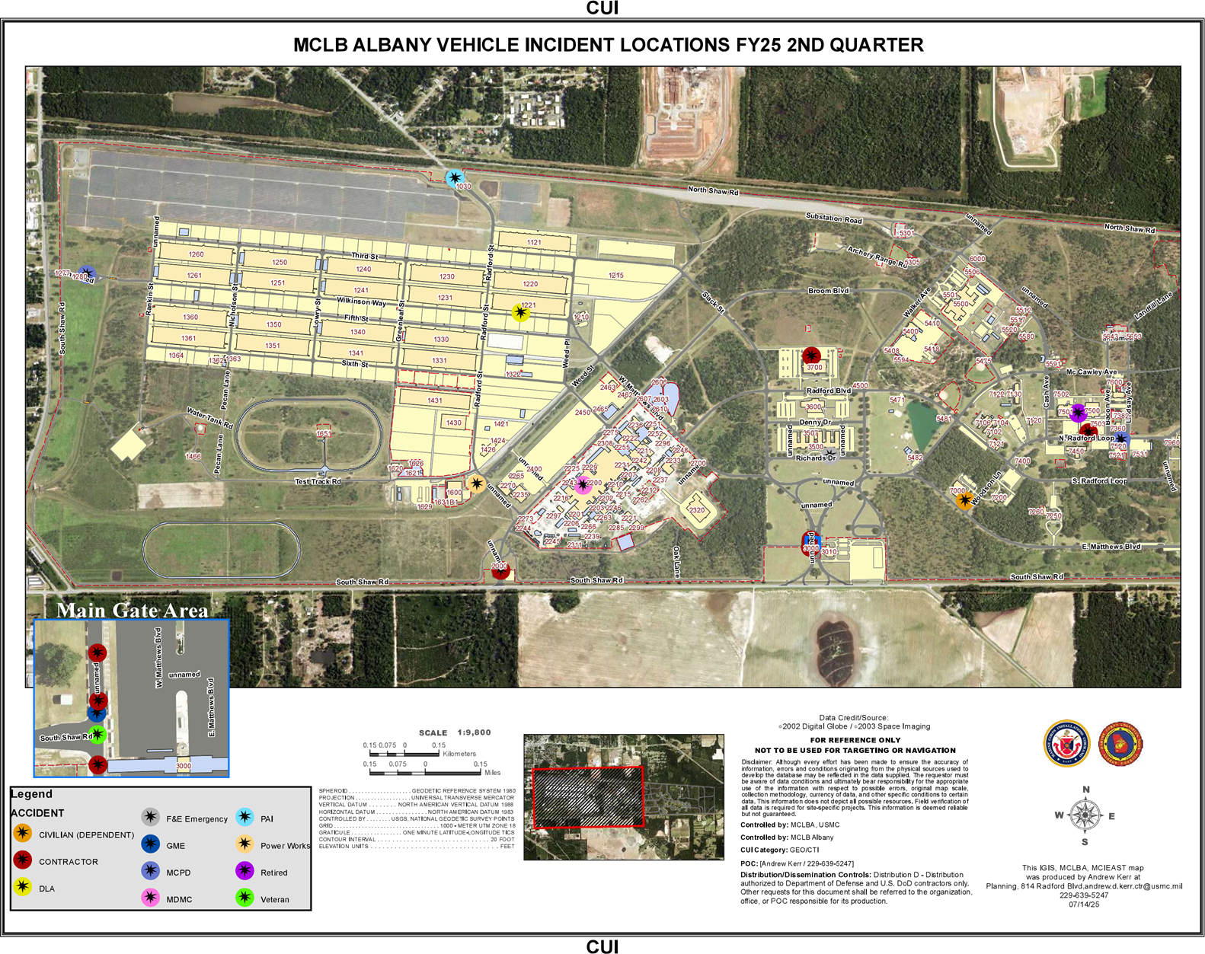

Slide 34

Injury Compensation
Federal Workers’ Compensation Program
Employees’ Compensation Operations & Management Portal (ECOMP) has become the preferred vehicle for processing new employee injury claims electronically.
All injuries should be reported using the electronic CA-1 or CA-2 forms which are within the ECOMP System
CA-1 and CA-2 forms should be processed by supervisors through the ECOMP System no later than 4 days following their employee’s injury as mandated by MPC-40.
Injury Status
Apr. | One injury. Employee is back at work.
May | No injuries reported.
June | No injuries reported.
Shelia Lester Florence Abria Johnson
Injury Compensation Program Administrator Alternate Injury Compensation Program Administrator
(229) 639-5244 (229) 639-5255

Slide 35
Annual Drug Testing Results (2020 thru 2025)

Slide 36


Radiation Safety Program
Activities:
  NONE
Current inventory as of 30 June 25:
  One (1) Telescope Elbow (MCSF-Blount Island Command).
  Twenty-Five (25) Aiming Post Alignment Devices (LSD).
  Forty-Seven (47) M67 Sight Mounts (General Accounts).
Johnny Little
Radiation Safety Manager
(229) 639-6721

Slide 37




Ergonomics
FY25 Council Theme:
VPP and Ergonomics
4. Safety and Health Training
According to Chapter 11, NAVMC Dir 5100.8, ergonomics awareness training shall be provided to all Marine Corps personnel. Training should enable each person to recognize work center ergonomic risk factors as well as understand procedures used to minimize these risks.
Ergonomics training is available on Waypoints, Safety Leaders Workshop, ergonomic assessments, and through the Risk Management Office.
Resource: Ground Safety for Marines (GSM) course manual, chap. 260, Ergonomics and VPP Elements
Whitney Hendrix
Ergonomics Program Manager
(229) 639-7052
ergonomics is the practice of fitting the workplace to the worker, not fitting the worker to the workplace. Ergonomics considers body dimensions, mobility, and the body’s stress behavior in the design of jobs, equipment, and work tasks

Slide 38
ALCOHOL/URINALYSIS SCREENING PROGRAM
FY25 3rd QUARTER TESTING RESULTS
SACO
2 = Alcohol Related Incident (ARI) for 3rd Qtr *Individuals were referred to the SACO Program and completed Prime for Life 16.0
0 = Drug Related Incidents (DRI) for 3rd Qtr
0 = Tested “Positive” of .02 or above for Breathalyzer Screening
Apr
8 - MARINES REPORTED FOR RANDOM BREATHALYZER
12 - MARINES WERE TESTED FOR THE MONTH- URINALYSIS
0 - TESTED POSITIVE FOR BREATHALYZER / URINALYSIS SCREENING
May
8 - MARINES REPORTED FOR RANDOM BREATHALYZER
14- MARINES WERE TESTED FOR THE MONTH- URINALYSIS
0 - TESTED POSITIVE FOR BREATHALYZER
Jun
8 - MARINES REPORTED FOR RANDOM BREATHALYZER
15-MARINES WERE TESTED FOR THE MONTH- URINALYSIS
0- TESTED POSITIVE FOR BREATHALYZER
SSgt Johnson Isaiah
Substance Assessment Coordination Officer
229-639-9106

Slide 39


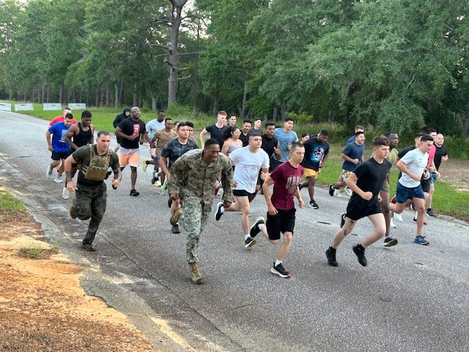
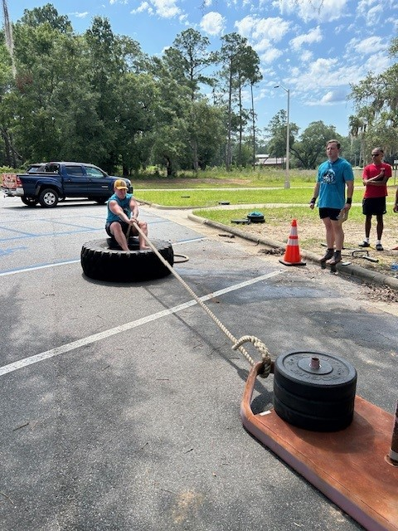
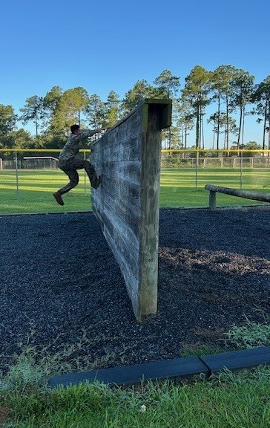

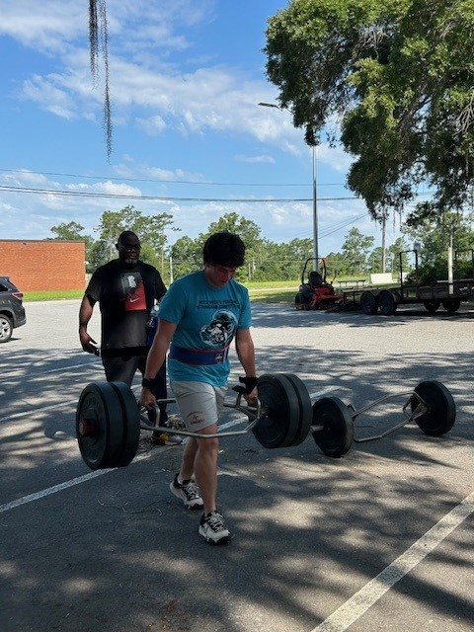
Recreation and Off-Duty Safety (RODS)
Reviewed the following Deliberate Risk Assessment Worksheets (DRAW) from JRAT:
1. Orca Strongman Competition
2. Bench Press Competition
3. Run-Swim-Run
4. E & O Course Timed Event
Whitney Hendrix
RODS Program Manager
(229) 639-7052

Slide 40

Explosives Safety
Regional explosive safety visit scheduled for 25-28 Aug 25.
Explosive Safety Inspection tentatively scheduled for 8-12 Dec 25.
Explosives Safety Officer
Rashode L. Best
(229) 639-6215

Slide 41
Hearing Conservation
Hearing Readiness Metrics CY25
(as of 30 June 25)
Reference: MCO 6260.3A, Marine Corps Hearing Conservation Program
Training requirements
Audiogram (Baseline, Annual, and Termination)
STS/PTS
Fit Testing
Identifying noise hazardous area and equipment
Best way to manage the military is by using MRRS
Alisha Montieth
Safety Specialist
639-7272
Notes:
Sir, we are briefing this slide , which was suggested by MCI as a way to provide the CO with a Hearing Readiness Status .
The Data on this side comes from ESAMS and MRRS
This slide covers the requirement for MCO 6260.3A, Marine Corps Hearing Conservation Program and the Readiness Metrics for CY20.
The Hearing Conservation Program’s requirements includes: Training, Audiogram, Significant Threshold Shift (STS) , Fit Testing , noise hazardous area and equipment inventory, etc.
Displayed on the chart, we have 192 personnel enrolled in the Hearing Conservation Program which are broken down by Department for CY20.
So far this calendar year, we currently have 151 audiogram that are in compliance.
We had No reported STS.
There are 6 termination audiogram reported and six baseline audiogram reported for the year.
Our Audiogram Compliance (AC) Rate is approximately 78%,.
The STS Rate is zero %.

Slide 42
MCLB Albany Medical Surveillance Program
(As of 1 August 2025)
Total % Compliant: 93.0 (554/596)
MCLBA Compliant (90% or >)
Marine Corps Compliant (85% or >, but <90%)
Non-Compliant (<85%)
Stacey Williams
Occupational Health Program Manager
(229)639-7049

Slide 43

Naval Medicine Readiness Training Unit
Albany, GA
Industrial Hygiene Assessment
Findings
Branch/Division/Command | IH Assessment Date/Findings
MCLBA – Manpower Division | Completed May 2025 0 findings
MCLBA – Operations and Training Division | Completed May 2025 0 Findings
Marine Corps Systems Command | Completed June 2025 0 Findings
MCLBA – Respiratory Program Review | Completed June 2025 1 Finding 87 of a 103 (84%) RP users were fully qualified to wear respiratory protection
MDMC PPA – Ordnance Branch (CWC 250) | Completed June 2025 0 Findings
MCLBA – HQ and Support Company | Completed July 2025 0 Findings
LADONNA SCHEURER
INDUSTRIAL HYGIENIST
NMRTU Albany IHPO
229-639-8458
JONATHAN RITTER
INDUSTRIAL HYGIENIST
NMRTU Albany IHPO
229-639-6408

Slide 44
GREAT SAFETY TRAINING OPPORTUNITIES
What: | VPP 101 | Safety Leaders Workshop
Who: | New employees and Marines that have not previously attended the course. | New supervisors and managers that have not previously attended the course. Employees are encouraged to attend.
When: | 7 August 2025, 0900-1000 4 September 2025. 0900-1000 2 October 2025, 0900-1000 | 2 – 3 Dec 2025
Where: | Building 3500, Wing 500, Room 504 | I&E Training Room – Bldg. 5500
Why: | MCLB Albany is an OSHA VPP Star Site, this training will help new employees and Marines understand what VPP is and learn how they can help the Command maintain Star status. | To impart a stronger sense of awareness of safety issues to the workforce and increase employee’s understanding of the impact and importance of a robust and effective safety and health program.
How: | Please contact your division training coordinator to reserve your seat.
Supervisors needing Safety Leader’s Workshop
Name |  | Division | Name |  | Division | Name |  | Division
1 | Christopher Mercer | PSD | 7 | Vondrell Patrick | HQ Co | 13
2 | SgtMaj Frank Kammer | Special Staff | 8 | Robert Richards | PSD | 14
3 | Col Matthew McKinney | Special Staff | 9 |  |  | 15
4 | Jonathan Caylor | PSD | 10 |  |  | 16
5 | Alejandro Nanez | PSD | 11
6 | Teddrick Parks | MCCS | 12
Notes:
Report pulled via ESAMS as to who needs the SLW forecasted out to 11/21/22.

Slide 45


Status of Formal Safety Training by Position
Unit | Name | Position | Trained | Course Schedule
HQ & Staff | Maj Barnard Sabin | Command Safety Officer | Yes | Ground Safety for Marines CY25 MCB CAMLEJ 15 Sep – 26 Sep 25
HQ Company | SSgt Kevin Chapman | Company Safety Officer | 26 Jul 24
Comptroller | Ms. Seketitia Jackson | Safety Representative | 4 Jun 25
LSD | Mr. Shane Mcintyre | Safety Officer | 7 Mar 25
OTD | Mrs. Whitney Hendrix | Safety Technician | 26 Apr 24
CISD | Mrs. Tammy Sisai | Safety Officer | 18 Dec 15
I&E | Mr. Frederick Peoples | Safety Officer | 17 May 24
PSD | Mr. Manual Gray | Safety Officer | 05 Feb 16
 |  |  |  | Ground Mishap Investigation Course CY25 MCB CAMLEJ 8 – 12 Sep 25
MCCS | Vacant | Safety Officer
PPA | Mr. Joseph Carson | Safety Manager | Yes
SYSCOM | Vacant | Safety Officer
MFSC | Vacant | Safety Manager
DDAG | Marisa Shorter | Safety Specialist | 7 Mar 25
General Accounts | Cpl Christopher Casilla | Safety Officer | 28 Oct 22
Marine Corps Safety Management System (MCSMS) 5100.29C, Chapter 5, Para 050302.C, dtd 15 Oct 20
Safety Officer Training: Commanders shall ensure that safety officers attend the Ground Safety For Marines Course (CIN# A-493-0047) within 90 days of assignment. ISMs will track and document training of all safety officers.

Slide 46



VPP ACTIVITIES
Completed for CY25
1. | OSHA VPP Self-Evaluation submitted on 4 Feb 25
2. | Three Risk Management personnel visited Cardinal for VPP mentorship on 8-10 April 25
3. | VPPPA 2025 Safety & Health Excellence Conference, Stone Mountain GA, 6-8 May 25 – Cancelled
Scheduled for CY25
2. | VPPPA 2025 Safety Symposium, St. Louis, MO, 11-14 August 25
Notes:
VPP Status Update..

Slide 47
CY25 Safety Award for 2nd Quarter
CO’s Safety Division Quarterly/Yearly Award Criteria will be based on the Division that earns the Highest Total Points, which involve the Four Elements of VPP. The formula for calculating total points earned is as follows: VPPSC Participation + Near Miss Report + Hazard Abatement + Training.
Management Leadership & Employee Involvement
Worksite Analysis
Hazard Prevention & Control
Safety & Health Training
Table 1: VPPSC Participation
Ranking Order | Points Earned
If member(s) from your division attend all scheduled VPPSC Meeting(s), the impact could be as much as 30 points earned. The points earned are assessed below.
Absentee | Points Earned
0 | 30 Points
1 | 15 Points
2 | 5 Points
> 2 | 0 Points
100% Participation | 30 Points
Table 2: Near Miss Report
Ranking Order | Points Earned
1st | 10 Points
2nd | 9 Points
3rd | 8 Points
4th | 7 Points
5th | 6 Points
6th | 5 Points
7th | 4 Points
8th | 3 Points
No Near Miss Report | 0 Points
Table 3: Hazard Abatement
Ranking Order | Points Earned
1st | 25 Points
2nd | 23 Points
3rd | 21 Points
4th | 19 Points
5th | 17 Points
6th | 15 Points
7th | 13 Points
8th | 11 Points
100% Hazard Abatement | 30 Points
Table 4: Training
Ranking Order | Points Earned
1st | 25 Points
2nd | 20 Points
3rd | 18 Points
4th | 16 Points
5th | 14 Points
6th | 12 Points
7th | 10 Points
8th | 8 Points
100% Required Training | 30 Points
Notes:
1 The maximum number of points a division can receive is 100 points.
2 Risk Management will query near miss report and training records in ESAMS for the previous CY Quarter/Year.
3 Risk Management will calculate each division near miss rate and training completion rate and rank rates from highest to lowest.
4 Risk Management will query ESAMS and determine the Hazard Abatement for each division and rank order from highest to lowest.
5 Using Table 1, add your VPPSC Participation points earned to your running score.
6 Using Table 2, add points earned according to your division's Near Miss Report ranking order to your running score.
7 Using Table 3, add the Hazard Abatement points earned according to your division ranking to your running score.
8 Using Table 4, add the Training (ESAMS) points earned according to your division's Training Ranking order to your running score.
9 Risk Management will rank final scores of each division.
10 The division with the highest total points earned will be selected as the Safety Award Winner for the Quarter/Year.

Slide 48

CO Guidance
Mark your Calendars
The next Safety Officer’s Council is:
29 Oct 25
The next Commanding Officer’s Safety Council is:
12 Nov 25

