Slide 1



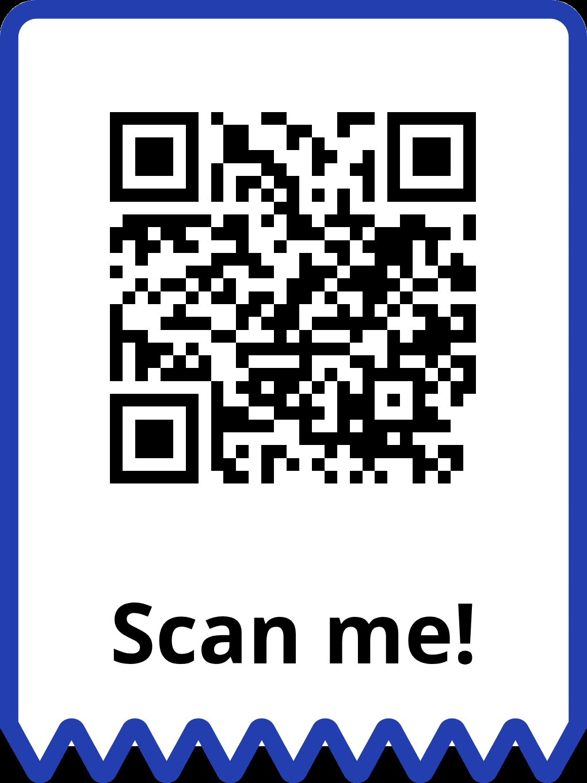
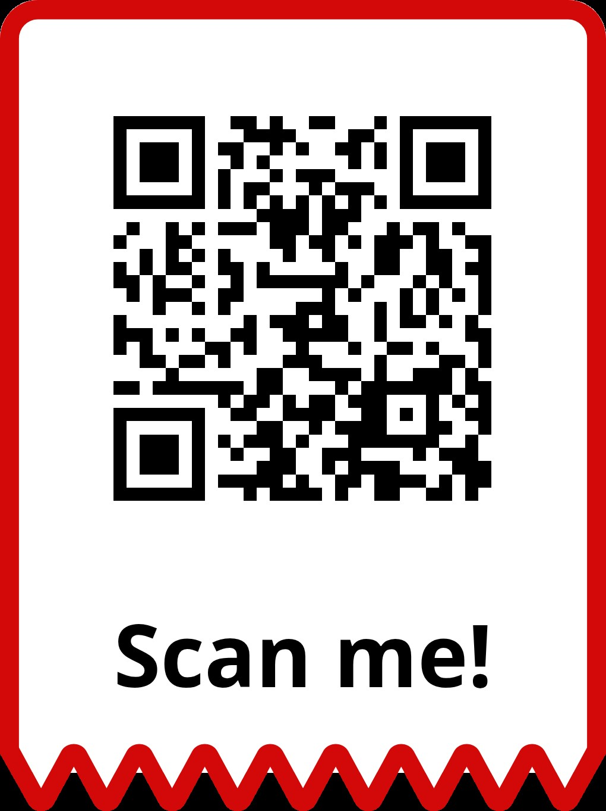
2026 BACK IN THE SADDLE
As we begin the new year, it’s essential to refocus on mission readiness and operational excellence through Back in the Saddle (BITS) training. This reorientation period is designed to ensure everyone returns to a state of heightened awareness, safety, and productivity. The Commanding Officer reminds all personnel to prioritize safety, adhere to established best practices, and actively participate in all scheduled activities. Supervisors are responsible for completing and submitting the BITS worksheet to their Division Training Officers no later than 1200, Thursday, 29 Jan 26. To streamline this process, use the links and QR codes below to access and distribute task documents efficiently. Let’s start strong and stay mission-focused! The documents are also available at: https://www.albany.marines.mil/Resources/MCLB-Offices-Staff/Risk-Management-Office/
 | Division/Branch/Office:
 | Participant Roster Employee Names: ____________________________________________________________ ____________________________________________________________ ____________________________________________________________ ____________________________________________________________ ____________________________________________________________ ____________________________________________________________ ____________________________________________________________ ____________________________________________________________ Supervisor Name: _________________________ Signature: ________________ Date: ________
 | Continuing a best practice for MCLB Albany Command Safety Program Requirements, Back in the Saddle training is encouraged following an extended holiday period.
Task 1: HEARING CONSERVATION
Supervisors must ensure all Marine and Civilian Marine employees receive their annual training on Hearing Conservation. Risk Management will provide the Hearing Conservation training presentation to civilian leadership to brief their employees. Marines will receive a briefing on hearing conservation from the Risk Management staff.
Task 2: REVIEW COMMAND SAFETY GOAL
Supervisors must review the 2026 Command Safety Goals and Objectives with their employees to ensure alignment with mission priorities. This discussion reinforces a shared commitment to workplace safety and operational excellence.
Task 3: REVIEW LOCAL SOP’S & UPDATE
Review and update local SOPs to ensure they align with the published MCLBAO P5100.1M. Supervisor need to remove outdated information and share updates promptly to maintain an efficient safety and health program.
Mission First - Safety Always!

