Slide 1




Marine Corps Logistics Base Albany
Commanding Officer’s Quarterly Safety Council
FY25 1st Quarter – 5 February 2025
PURPOSE
The purpose of the Safety Council is to review the installation and tenant safety performance and program effectiveness, to recommend changes to reduce unsafe practices and to strengthen the overall program.
(MCO 5100.29C Vol 1, Chap. 2, Para. 0204.F)
This meeting serves as the command:
Safe Driving Council (MCO 5100.29C, Vol 3, Chap. 7, Para. 0708.I)
Ergonomics Committee Meeting (NAVMC DIR 5100.8 Chap. 19, Para. 19003)
AGENDA
Goals
Performance Metrics
Inspections
Unit Safety Reports
GOV Fleet Safety
Traffic Safety
MCFD
MCPD
Base Traffic Court
Injury Compensation
Ergonomics
RASP
Explosives Safety
SACO
Hearing Conservation
IH Surveys
Safety Training
VPP Activities
Safety Awards
Open Discussion
CO Guidance

Slide 2



Emergency Evacuation
Coffman Hall Evacuation Routes
Muster by the cannons
2

Slide 3

CY24 Command Safety Program Goals
MCLB Albany
GOAL: Increase Medical Surveillance Compliance (90% or Greater)
Background: Occupational Medical Surveillance is the systematic process of monitoring the health of Marines and Civilian Marines exposed to specific hazardous substances or conditions in the workplace. Examples of such hazards include asbestos, noise, lead, ionizing radiation, hearing, etc. Medical surveillance compliance for MCLB Albany Marines is currently 74% and 88% for Civilian Marines for assigned stressors. This means over 26% of Marines and approximately 12% of Civilian Marines are delinquent primarily because of overdue medical surveillance examinations.
References: 29 CFR 1910.120(f) and MCO 5100.29C Volume 1
Goal: Achieve at least 90% for Marines and Civilians Marines overall medical surveillance.
Target Date: 1 December 2024
Goal Leader: Division Directors, Special Staff and HQ Company Commander
Goal Progress Reporting: Division Directors and HQ Company Commander will brief the progress of this goal at the Commanding Officer’s Quarterly Safety Council.
 | Objective | Objective Leader | Completion Date
1 | All supervisors will attend training provided by the Risk Management Staff on the use of Supervisor’s Medical Surveillance and Certification Exam Referral form and the use of Occupational Medical Surveillance System (OMSS) in ESAMS. Safety Officers will coordinate the training schedule with the Risk Management Staff. | Division Directors, Special Staff and HQ Company Commander | 31 March 2024
2 | Supervisors will identify, assign, and document all occupational related medical surveillance stressors (i.e. hearing, respiratory, bloodborne pathogens, forklift, etc.) accordingly in OMSS for each employee. | Division Directors, Special Staff and HQ Company Commander | 30 June 2024
3 | Supervisors will enter the most recent physical exams for each assigned stressor in OMSS for each employee requiring medical surveillance. | Division Directors, Special Staff and HQ Company Commander | 31 October 2024
4 | Every employee will be current in Medical Surveillance and Certification Exams. Supervisors will document the results using OMSS in ESAMS. | Division Directors, Special Staff and HQ Company Commander | 1 December 2024
Assessment Criteria
No Action | In-Progress | Completed

Slide 4
CY25 Command Safety Program Goal
MCLB Albany
GOAL: Reduce Life Safety Code Findings by 30%
Background: Risk Management has identified a significant increase in Life Safety Code findings, with a 23% surge in CY24 compared to CY23, accounting for over 20% of all safety findings in the past five years. Many of these hazards could have been identified and resolved by employees, highlighting a need for increased awareness and responsibility. This goal focuses on addressing these hazards by ensuring regular inspections of fire extinguishers, maintaining functional emergency/exit lights, and keeping fire exits clear. These actions aim to reduce safety risks, improve compliance, and foster a culture of safety, ultimately ensuring a safer and more efficient workplace while supporting our mission.
References: 29 CFR 1910 Subpart E and NFPA 101-2024 each require compliance with established fire safety standards to preserve the safety and health of employees and protect facilities.
Goal: Reduce Life Safety Code hazards by 30%, with no more than 25 findings total during CY25, as tracked in ESAMS.
Target Date: 30 June 2025
Goal Leader: Division Directors, Special Staff and HQ Company Commander
Goal Progress Reporting: Division Directors and HQ Company Commander will brief the progress of this goal at the Commanding Officer’s Quarterly Safety Council.
 | Objective | Objective Leader | Completion Date
1 | Division Directors will formally appoint Fire Wardens in writing for each work area, shop, or facility under their responsibility. | Division Directors, Special Staff and HQ Company Commander | 28 February 2025
2 | Division Directors will ensure fire wardens complete initial or refresher training through MCLBA’s Fire Prevention section, equipping them with the knowledge and skills necessary to conduct fire safety inspections effectively. | Division Directors, Special Staff and HQ Company Commander | 31 March 2025
3 | Division Directors will ensure 90% of the workforce completes the Fire Prevention and Portable Fire Extinguisher Training and Education (1024) module in ESAMS. | Division Directors, Special Staff and HQ Company Commander | 1 April 2025
4 | Division Directors will ensure that every employee participates in at least one documented safety and occupational health inspection of their work areas, with a specific focus on identifying Life Safety Code hazards such as uninspected fire extinguishers, non-working emergency/exit lights, and blocked fire exits. | Division Directors, Special Staff and HQ Company Commander | 30 June 2025
Assessment Criteria
No Action | In-Progress | Completed

Slide 5
Performance Metrics as of 31 Dec 24
CY20-CY24 Military RMI-SIR Cases
CY20-CY24 Civilian Lost Day Cases
6
2
Notes:
Military RMI-SIR Cases:
9/20/22 – SNM Bitten by an insect on the hand – No lost time
7/6/22 – SNM Playing PT soccer in gym. Marine stepped on foot and suffered fractured right foot -30 Days Light Duty
5/9/22 – SNM right hand struck while repairing motor assembly of POV. OFF Duty – 7 days light duty
3/12/22 – SNM left pinky finger on left hand was dislocated attempting to catch a football. OFF Duty – Splint 30 Days
3/17/21 – SNM struck bench at home and broke right hand. OFF Duty – 3 days Lost Time and 30-90 days Light Duty
3/22/21 – SNM hit back of head against a cabinet shelf left open. OFF Duty – 2 days Lost Time and 18 days Light Duty
5/18/21 – SNM rolled and sprained left ankle during personal PT. OFF Duty – 14 days Light Duty
5/24/21 – SNM smashed middle finger on left hand between kennel food bowl and wall. ON Duty – Splint 30 days
7/24/21 – SNM bitten by dog on right elbow. OFF Duty – Medication
Civilian Lost Day Cases:
9/6/22 – While performing a training exercise, employee was accidentally dropped onto the floor by another employee – 5 days Lost Time
8/10/22 – Employee fell and struck head while attempting to sit in office chair. 4 days Lost Time
3/29/21 – Employee struck in forehead with toy. 3 days Lost Time

Slide 6



OSHA Injury/Illness Rates
as of 31 Dec 24
OSHA RECORDABLE CASES
Calendar Year | # of Cases
2012 | 14
2013 | 9
2014 | 9
2015 | 8
2016 | 8
2017 | 6
2018 | 5
2019 | 8
2020 | 5
2021 | 5
2022 | 5
2023 | 4
2024 | 2
MCLB Albany Injury Rates (31 Dec 24)
MCLB Albany | CY12 | CY13 | CY14 | CY15 | CY16 | CY17 | CY18 | CY19 | CY20 | CY21 | CY22 | CY23 | CY24
DART | 0.5 | 1.0 | 0.5 | 0.7 | 0.5 | 0.4 | 0.5 | 0.2 | 0.8 | 0.6 | 0.4 | 0.7 | 0.9
TCIR | 2.4 | 1.5 | 1.5 | 1.5 | 1.5 | 1.1 | 0.9 | 1.4 | 0.9 | 1.0 | 0.9 | 0.9 | 0.9
NAICS | CY12 | CY13 | CY14 | CY15 | CY16 | CY17 | CY18 | CY19 | CY20 | CY21 | CY22 | CY23 | MCLB Albany 3-Year Average (CY21-CY23)
DART | 1.8 | 1.9 | 1.5 | 1.2 | 1.8 | 2.1 | 1.5 | 1.8 | 3.2 | 2.8 | 1.8 | 1.8 | 0.7
TCIR | 3.6 | 3.8 | 3.1 | 2.3 | 3.2 | 3.5 | 3.5 | 3.0 | 4.5 | 3.8 | 3.2 | 3.2 | 0.9
Notes:
CY22
1st Quarter
None
2nd Quarter
5/9/22 – SNM right hand struck while repairing motor assembly of POV. OFF Duty – 7 days light duty
3rd Quarter
8/10/22 – Employee fell and struck head while attempting to sit in office chair. 4 days Lost Time
9/6/22 – While performing a training exercise, employee was accidentally dropped onto the floor by another employee – 5 days Lost Time
4th Quarter

Slide 7


Inspections
FY25 – 1st Qtr
2nd Network Battalion
GA Army National Guard
Public Health Albany
Diversified Service Contracting (DSC)
Human Resource Office (HRO)

Slide 8
FY20 - FY24 Inspection Findings
(Includes All Organizations)
as of 31 Dec 24
Risk Assessment Code for all findings
 | FY 20 | FY 21 | FY 22 | FY 23 | FY 24
RAC 1 | 0 | 0 | 0 | 0 | 0
RAC 2 | 0 | 4 | 0 | 0 | 0
RAC 3 | 15 | 22 | 12 | 9 | 14
RAC 4 | 187 | 174 | 180 | 222 | 287
RAC 5 | 51 | 72 | 46 | 36 | 54
Total | 253 | 272 | 238 | 267 | 355
# of Findings
Notes:
This information includes data from the following inspections performed for FY22:
1st Qtr – 15 small tenants, I&E, and MCCS
2nd Qtr – PSD, HQ CO, Special Staff, OTD, Comptroller, Manpower, CISD, MCCS, PPA, and PowerWorks.
3rd Qtr – LSD, MFSC, and DLA; pending CDC, and I&E.
4th Qtr –
This information includes data from the following inspections performed in FY23
1st Quarter – CDC, I&E, LSD, MARCORLOGCOM, 15 Small Tenants

Slide 9
FY20 - FY24 Inspection Findings
MCLB Albany
as of 31 Dec 24
Risk Assessment Code for all findings
 | FY 20 | FY 21 | FY 22 | FY 23 | FY 24
RAC 1 | 0 | 0 | 0 | 0 | 0
RAC 2 | 0 | 4 | 0 | 0 | 0
RAC 3 | 9 | 16 | 2 | 7 | 11
RAC 4 | 77 | 75 | 73 | 110 | 75
RAC 5 | 51 | 73 | 43 | 22 | 60
Total | 137 | 168 | 118 | 139 | 146
# of Findings
Notes:
This information includes data from the following inspections performed for FY22:
1st Qtr - I&E and MCCS
2nd Qtr – PSD, HQ CO, Special Staff, OTD, Comptroller, Manpower, CISD, and MCCS.
3rd Qtr – DDAG, LSD, CDC (quarterly), I&E
4th Qtr - …

Slide 10
Safety and Occupational Health Inspections
FY22 Abatement Efficiency Index: 99%
1% or (3) of the (238) Findings identified by Safety & Occupational Health Inspections during FY22 were not documented as abated within 30 days.
Supervisor Responsibility: “Provide for or ensure abatement of all identified workplace OSH deficiencies.” NAVMC Dir 5100.8, Chap. 7 Para 7004.4.f
Open Findings as of 31 Dec 24
UNIT | Number | RAC
DDAG | 1 | 4
PSD | 2 | 4
Total | 3
The Unit Safety Officer is responsible for maintaining a hazard abatement log, monitoring the corrective actions (Work Requests) taken, and reporting the status to the Risk Management Office.
Notes:
6 of the 272 findings for FY21 are still open as of 15 Apr 22. Which gives us an 98% Abatement Efficiency index.

Slide 11
Safety and Occupational Health Inspections
FY23 Abatement Efficiency Index: 99%
1% or (1) of the (267) Findings identified by Safety & Occupational Health Inspections during FY23 were not documented as abated within 30 days.
Supervisor Responsibility: “Provide for or ensure abatement of all identified workplace OSH deficiencies.” NAVMC Dir 5100.8, Chap. 7 Para 7004.4.f
Open Findings as of 31 Dec 24
UNIT | Number | RAC
I&E | 1 | 3
Total | 1
The Unit Safety Officer is responsible for maintaining a hazard abatement log, monitoring the corrective actions (Work Requests) taken, and reporting the status to the Risk Management Office.
Notes:
24 of the 161 findings for FY22 are still open as of 27 Apr 22, which gives us an 83% Abatement Efficiency index.
1st Qtr data input - 15 small tenants, I&E, and MCCS
2nd Qtr data input - PSD, HQ CO, Special Staff, OTD, Comptroller, Manpower, CISD, MCCS, PPA, and PowerWorks.
3rd Qtr data input - includes LSD, MFSC, and DLA data, CDC and I&E.
4th Qtr data input -

Slide 12
Safety and Occupational Health Inspections
FY24 Abatement Efficiency Index: 88%
11% or (41) of the (355) Findings identified by Safety & Occupational Health Inspections during FY24 are not documented as abated within 30 days.
Supervisor Responsibility: “Provide for or ensure abatement of all identified workplace OSH deficiencies.” NAVMC Dir 5100.8, Chap. 7 Para 7004.4.f
Open Findings as of 31 Dec 24
UNIT | Number | RAC
DDAG | 5 | 3/4
General Accounts | 7 | 4
PowerWorks | 8 | 4
PSD | 11 | 4/5
DECA | 2 | 4
MCCS | 8 | 3/4/5
Total | 41
The Unit Safety Officer is responsible for maintaining a hazard abatement log, monitoring the corrective actions (Work Requests) taken, and reporting the status to the Risk Management Office.
Notes:
24 of the 161 findings for FY22 are still open as of 27 Apr 22, which gives us an 83% Abatement Efficiency index.
1st Qtr data input - 15 small tenants, I&E, and MCCS
2nd Qtr data input - PSD, HQ CO, Special Staff, OTD, Comptroller, Manpower, CISD, MCCS, PPA, and PowerWorks.
3rd Qtr data input - includes LSD, MFSC, and DLA data, CDC and I&E.
4th Qtr data input -

Slide 13
Report of Near Miss
ESAMS recorded 4 valid Near Miss* Reports for this quarter
*A Near Miss is defined as: Conditions that exist or incidents that occur without injury or property damage. Near misses include unsafe or unhealthful actions, behaviors, or working conditions that did not result in a mishap. (MCLBAO P5100.1L CH 1)
4th Quarter CY24
Stacey Williams
Safety Specialist/Program Manager
639-7049
Notes:
This is a summary of the near miss reports submitted for the 2nd quarter for the Calendar Year.
We had a total of 2 valid Near Miss reports submitted during the 2nd quarter.
Slips, Trips and Fall is leading in the trends of near miss reported followed by other incidents.
A break down of near miss reports are shown by Divisions.

Slide 14
Unit Safety Reports
Briefing Order:
H&S Company
OTD
Manpower
Comptroller
LSD
CISD
I&E
PSD
MCCS
DLA
Notes:
Units with a reported mishap or injuries will brief their information.
Brief by exception. Slides are hidden, but we maintain the data.

Slide 15



Headquarters Company
 | Objective | Objective Leader | Completion Date
1 | All supervisors will attend training provided by the Risk Management Staff on the use of Supervisor’s Medical Surveillance and Certification Exam Referral form and the use of Occupational Medical Surveillance System (OMSS) in ESAMS. Safety Officers will coordinate the training schedule with the Risk Management Staff. | Division Directors, Special Staff and HQ Company Commander | 31 March 2024
2 | Supervisors will identify, assign, and document all occupational related medical surveillance stressors (i.e. hearing, respiratory, bloodborne pathogens, forklift, etc.) accordingly in OMSS for each employee. | Division Directors, Special Staff and HQ Company Commander | 30 June 2024
3 | Supervisors will enter the most recent physical exams for each assigned stressor in OMSS for each employee requiring medical surveillance. | Division Directors, Special Staff and HQ Company Commander | 31 October 2024
4 | Every employee will be current in Medical Surveillance and Certification Exams. Supervisors will document the results using OMSS in ESAMS. | Division Directors, Special Staff and HQ Company Commander | 1 December 2024
NO ACTION IN PROGRESS COMPLETED
Notes:
Quadrant 1-Injury / rate chart- no change-fill in data sheet and display the chart.
Quadrant 2-OSHA Data. We have filled in the previous data. Put in your current information. Near miss will include any from your personnel we have AND any you have received that we did not.
Quadrant 3 Property damage. List any you have had. Previous quarters should be up-to-date. We want cumulative for the CY.
Quadrant 4

Slide 16
Narrative of Military RMI-SIR Cases CY24
1st Qtr. | Date | Narrative | Status | Results
 | 3/17/24 | SNM stepped on a nail while walking dog. Resulting in a puncture in right foot. | OFF DUTY | 7-day restriction/Tetanus shot
2nd Qtr. | 4/16/24 | SNM slid off rope at obstacle course, causing dermal abrasion to both hands. | OFF DUTY | 3-day restricted duty/NLT
 | 4/27/24 | SNM stumbled and twisted left foot while cleaning kennel. | On Duty | 14- day restricted duty/NLT
3rd Qtr. | 9/4/24 | SNM was cut while cleaning the dishes. Resulting in laceration to the right thumb. | OFF DUTY | No restrictions/ NLT
 | 9/5/24 | SNM bit by military working dog. Resulting in puncture wound on left thumb. | On Duty | 1-lost day
 | 9/5/24 | SNM was struck on the nose by leash buckle while training military working dog. | On Duty | First Aid only
4th Qtr. | NONE
On duty
Off duty
Lost time
Restriction
Other
First Aid

Slide 17



Operations and Training Division
 | Objective | Objective Leader | Completion Date
1 | All supervisors will attend training provided by the Risk Management Staff on the use of Supervisor’s Medical Surveillance and Certification Exam Referral form and the use of Occupational Medical Surveillance System (OMSS) in ESAMS. Safety Officers will coordinate the training schedule with the Risk Management Staff. | Division Directors, Special Staff and HQ Company Commander | 31 March 2024
2 | Supervisors will identify, assign, and document all occupational related medical surveillance stressors (i.e. hearing, respiratory, bloodborne pathogens, forklift, etc.) accordingly in OMSS for each employee. | Division Directors, Special Staff and HQ Company Commander | 30 June 2024
3 | Supervisors will enter the most recent physical exams for each assigned stressor in OMSS for each employee requiring medical surveillance. | Division Directors, Special Staff and HQ Company Commander | 31 October 2024
4 | Every employee will be current in Medical Surveillance and Certification Exams. Supervisors will document the results using OMSS in ESAMS. | Division Directors, Special Staff and HQ Company Commander | 1 December 2024
NO ACTION IN PROGRESS COMPLETED
Notes:
Base ops and civilian training, PAO, Mission assurance branch
Quadrant 1-Injury / rate chart- no change-fill in data sheet and display the chart.
Quadrant 2-OSHA Data. We have filled in the previous data. Put in your current information. Near miss will include any from your personnel we have AND any you have received that we did not.
Quadrant 3 Property damage. List any you have had. Previous quarters should be up-to-date. We want cumulative for the CY.
Quadrant 4 Progress toward Command Safety Goals. Each goal has several objectives. The objective status box will be red, yellow or green depending upon your unit progress toward the objective. If you have done nothing yet, the box is red. If you are working on it, the box is yellow. You can enter a % complete in the box. If all is complete, the box is green. The far right box is progress on the complete goal. Red if no progress, yellow if working but not all objectives are complete, Green when all is complete.

Slide 18



Manpower
 | Objective | Objective Leader | Completion Date
1 | All supervisors will attend training provided by the Risk Management Staff on the use of Supervisor’s Medical Surveillance and Certification Exam Referral form and the use of Occupational Medical Surveillance System (OMSS) in ESAMS. Safety Officers will coordinate the training schedule with the Risk Management Staff. | Division Directors, Special Staff and HQ Company Commander | 31 March 2024
2 | Supervisors will identify, assign, and document all occupational related medical surveillance stressors (i.e. hearing, respiratory, bloodborne pathogens, forklift, etc.) accordingly in OMSS for each employee. | Division Directors, Special Staff and HQ Company Commander | 30 June 2024
3 | Supervisors will enter the most recent physical exams for each assigned stressor in OMSS for each employee requiring medical surveillance. | Division Directors, Special Staff and HQ Company Commander | 31 October 2024
4 | Every employee will be current in Medical Surveillance and Certification Exams. Supervisors will document the results using OMSS in ESAMS. | Division Directors, Special Staff and HQ Company Commander | 1 December 2024
NO ACTION IN PROGRESS COMPLETED
Notes:
July: Employee sustained injuries to the lower back and right leg when they fell over industrial fan.
August:
1) LOST TIME: Employee sustained a broken left foot then they lost their footing and fell down a set of stairs.
2) Employee sustained a laceration to the finger due to a Military working dog bite.

Slide 19



Office of the Comptroller
 | Objective | Objective Leader | Completion Date
1 | All supervisors will attend training provided by the Risk Management Staff on the use of Supervisor’s Medical Surveillance and Certification Exam Referral form and the use of Occupational Medical Surveillance System (OMSS) in ESAMS. Safety Officers will coordinate the training schedule with the Risk Management Staff. | Division Directors, Special Staff and HQ Company Commander | 31 March 2024
2 | Supervisors will identify, assign, and document all occupational related medical surveillance stressors (i.e. hearing, respiratory, bloodborne pathogens, forklift, etc.) accordingly in OMSS for each employee. | Division Directors, Special Staff and HQ Company Commander | 30 June 2024
3 | Supervisors will enter the most recent physical exams for each assigned stressor in OMSS for each employee requiring medical surveillance. | Division Directors, Special Staff and HQ Company Commander | 31 October 2024
4 | Every employee will be current in Medical Surveillance and Certification Exams. Supervisors will document the results using OMSS in ESAMS. | Division Directors, Special Staff and HQ Company Commander | 1 December 2024
NO ACTION IN PROGRESS COMPLETED

Slide 20
Logistics Support Division
No update provided
 | Objective | Objective Leader | Completion Date
1 | All supervisors will attend training provided by the Risk Management Staff on the use of Supervisor’s Medical Surveillance and Certification Exam Referral form and the use of Occupational Medical Surveillance System (OMSS) in ESAMS. Safety Officers will coordinate the training schedule with the Risk Management Staff. | Division Directors, Special Staff and HQ Company Commander | 31 March 2024
2 | Supervisors will identify, assign, and document all occupational related medical surveillance stressors (i.e. hearing, respiratory, bloodborne pathogens, forklift, etc.) accordingly in OMSS for each employee. | Division Directors, Special Staff and HQ Company Commander | 30 June 2024
3 | Supervisors will enter the most recent physical exams for each assigned stressor in OMSS for each employee requiring medical surveillance. | Division Directors, Special Staff and HQ Company Commander | 31 October 2024
4 | Every employee will be current in Medical Surveillance and Certification Exams. Supervisors will document the results using OMSS in ESAMS. | Division Directors, Special Staff and HQ Company Commander | 1 December 2024
NO ACTION IN PROGRESS COMPLETED

Slide 21

Communications and Information Systems Division
 | Objective | Objective Leader | Completion Date
1 | All supervisors will attend training provided by the Risk Management Staff on the use of Supervisor’s Medical Surveillance and Certification Exam Referral form and the use of Occupational Medical Surveillance System (OMSS) in ESAMS. Safety Officers will coordinate the training schedule with the Risk Management Staff. | Division Directors, Special Staff and HQ Company Commander | 31 March 2024
2 | Supervisors will identify, assign, and document all occupational related medical surveillance stressors (i.e. hearing, respiratory, bloodborne pathogens, forklift, etc.) accordingly in OMSS for each employee. | Division Directors, Special Staff and HQ Company Commander | 30 June 2024
3 | Supervisors will enter the most recent physical exams for each assigned stressor in OMSS for each employee requiring medical surveillance. | Division Directors, Special Staff and HQ Company Commander | 31 October 2024
4 | Every employee will be current in Medical Surveillance and Certification Exams. Supervisors will document the results using OMSS in ESAMS. | Division Directors, Special Staff and HQ Company Commander | 1 December 2024
NO ACTION IN PROGRESS COMPLETED
Notes:
July: Employee sustained injuries to the lower back and right leg when they fell over industrial fan.
August:
1) LOST TIME: Employee sustained a broken left foot then they lost their footing and fell down a set of stairs.
2) Employee sustained a laceration to the finger due to a Military working dog bite.

Slide 22



Installation & Environment Division
 | Objective | Objective Leader | Completion Date
1 | All supervisors will attend training provided by the Risk Management Staff on the use of Supervisor’s Medical Surveillance and Certification Exam Referral form and the use of Occupational Medical Surveillance System (OMSS) in ESAMS. Safety Officers will coordinate the training schedule with the Risk Management Staff. | Division Directors, Special Staff and HQ Company Commander | 31 March 2024
2 | Supervisors will identify, assign, and document all occupational related medical surveillance stressors (i.e. hearing, respiratory, bloodborne pathogens, forklift, etc.) accordingly in OMSS for each employee. | Division Directors, Special Staff and HQ Company Commander | 30 June 2024
3 | Supervisors will enter the most recent physical exams for each assigned stressor in OMSS for each employee requiring medical surveillance. | Division Directors, Special Staff and HQ Company Commander | 31 October 2024
4 | Every employee will be current in Medical Surveillance and Certification Exams. Supervisors will document the results using OMSS in ESAMS. | Division Directors, Special Staff and HQ Company Commander | 1 December 2024
NO ACTION IN PROGRESS COMPLETED
Notes:
Quadrant 1-Injury / rate chart- no change-fill in data sheet and display the chart.
Quadrant 2-OSHA Data. We have filled in the previous data. Put in your current information. Near miss will include any from your personnel we have AND any you have received that we did not.
Quadrant 3 Property damage. List any you have had. Previous quarters should be up-to-date. We want cumulative for the CY.
Quadrant 4

Slide 23
Public Safety Division
 | Objective | Objective Leader | Completion Date
1 | All supervisors will attend training provided by the Risk Management Staff on the use of Supervisor’s Medical Surveillance and Certification Exam Referral form and the use of Occupational Medical Surveillance System (OMSS) in ESAMS. Safety Officers will coordinate the training schedule with the Risk Management Staff. | Division Directors, Special Staff and HQ Company Commander | 31 March 2024
2 | Supervisors will identify, assign, and document all occupational related medical surveillance stressors (i.e. hearing, respiratory, bloodborne pathogens, forklift, etc.) accordingly in OMSS for each employee. | Division Directors, Special Staff and HQ Company Commander | 30 June 2024
3 | Supervisors will enter the most recent physical exams for each assigned stressor in OMSS for each employee requiring medical surveillance. | Division Directors, Special Staff and HQ Company Commander | 31 October 2024
4 | Every employee will be current in Medical Surveillance and Certification Exams. Supervisors will document the results using OMSS in ESAMS. | Division Directors, Special Staff and HQ Company Commander | 1 December 2024
NO ACTION IN PROGRESS COMPLETED

Slide 24
Public Safety Division
 | Objective | Objective Leader | Completion Date
1 | All supervisors will attend training provided by the Risk Management Staff on the use of Supervisor’s Medical Surveillance and Certification Exam Referral form and the use of Occupational Medical Surveillance System (OMSS) in ESAMS. Safety Officers will coordinate the training schedule with the Risk Management Staff. | Division Directors, Special Staff and HQ Company Commander | 31 March 2024
2 | Supervisors will identify, assign, and document all occupational related medical surveillance stressors (i.e. hearing, respiratory, bloodborne pathogens, forklift, etc.) accordingly in OMSS for each employee. | Division Directors, Special Staff and HQ Company Commander | 30 June 2024
3 | Supervisors will enter the most recent physical exams for each assigned stressor in OMSS for each employee requiring medical surveillance. | Division Directors, Special Staff and HQ Company Commander | 31 October 2024
4 | Every employee will be current in Medical Surveillance and Certification Exams. Supervisors will document the results using OMSS in ESAMS. | Division Directors, Special Staff and HQ Company Commander | 1 December 2024
NO ACTION IN PROGRESS COMPLETED

Slide 25


Marine Corps Community Services
 | Objective | Objective Leader | Completion Date
1 | All supervisors will attend training provided by the Risk Management Staff on the use of Supervisor’s Medical Surveillance and Certification Exam Referral form and the use of Occupational Medical Surveillance System (OMSS) in ESAMS. Safety Officers will coordinate the training schedule with the Risk Management Staff. | Division Directors, Special Staff and HQ Company Commander | 31 March 2024
2 | Supervisors will identify, assign, and document all occupational related medical surveillance stressors (i.e. hearing, respiratory, bloodborne pathogens, forklift, etc.) accordingly in OMSS for each employee. | Division Directors, Special Staff and HQ Company Commander | 30 June 2024
3 | Supervisors will enter the most recent physical exams for each assigned stressor in OMSS for each employee requiring medical surveillance. | Division Directors, Special Staff and HQ Company Commander | 31 October 2024
4 | Every employee will be current in Medical Surveillance and Certification Exams. Supervisors will document the results using OMSS in ESAMS. | Division Directors, Special Staff and HQ Company Commander | 1 December 2024
NO ACTION IN PROGRESS COMPLETED
Notes:
Quadrant 1-Injury / rate chart- no change-fill in data sheet and display the chart.
Quadrant 2-OSHA Data. We have filled in the previous data. Put in your current information. Near miss will include any from your personnel we have AND any you have received that we did not.
Quadrant 3 Property damage. List any you have had. Previous quarters should be up-to-date. We want cumulative for the CY.
Quadrant 4 Progress toward Command Safety Goals. Each goal has several objectives. The objective status box will be red, yellow or green depending upon your unit progress toward the objective. If you have done nothing yet, the box is red. If you are working on it, the box is yellow. You can enter a % complete in the box. If all is complete, the box is green. The far right box is progress on the complete goal. Red if no progress, yellow if working but not all objectives are complete, Green when all is complete.

Slide 26

DLA Distribution Albany Georgia
Successes, Initiatives, and Concerns
DLA Distribution Albany: Increased adherence to personal protective equipment protocols through regular audits and reminders. Continuously encouraging continued focus on safety improvements and invite suggestions for future initiatives. Increased near-miss reporting, promoting proactive identification of risks before they result in accidents.
Notes:
26
26
Quadrant 1-Injury / rate chart- no change-fill in data sheet and display the chart.
Quadrant 2-OSHA Data. We have filled in the previous data. Put in your current information. Near miss will include any from your personnel we have AND any you have received that we did not.
Quadrant 3 Property damage. List any you have had. Previous quarters should be up-to-date. We want cumulative for the CY.
Quadrant 4 Successes etc. This is for you to put in and blow your horn. Share with us. If you have a problem or concern, share, it.

Slide 27
GOV Fleet Safety
GOV Damage
Ms. Kelly Eadie
Director, LSD
(229) 639-6733
Notes:
GOV damage values only. Ensure no other non-GOV property damages are added on this chart.
Note on lowest and highest quarters.

Slide 28
FY24 GOV and Real Property Damage Cases
Quarter | Date | Narrative | Cost
1st Qtr | 5 Nov 24 | LSD – GOV struck yellow pillar while pulling into gas pump | $5447.00
 | 16 Dec 24 | LSD – GOV struck electric cord reel while backing up, causing damage to passenger side mirror | $100.00
Total |  | 2 Property Damages | $5547.00
Total reimbursable: $0
Notes:
Difference between the total on this slide and GOV Damage is that this slide includes other incidents of property damages.
1st Qtr - $3000 Light pole in collision
2nd Qtr - $2400 POV damaged wall at Auto-Hobby Shop. Covered by POV insurance.
3rd Qtr - $550 Shattered rear e-cart window covered by contractor.
4th Qtr - $438 Damage to front axle on trailer from striking a protective barrier

Slide 29
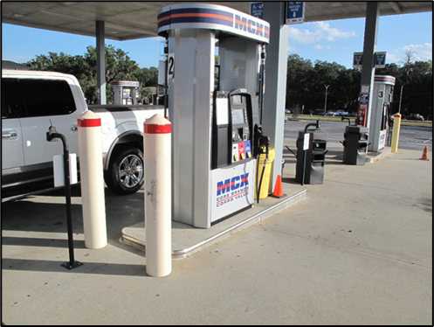
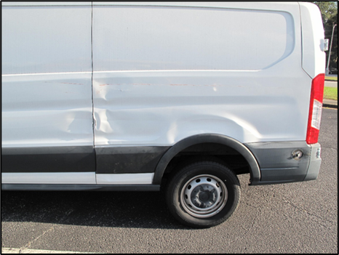

Property Damages
LSD – GOV struck yellow pillar while pulling into gas pump
$5447.00

Slide 30
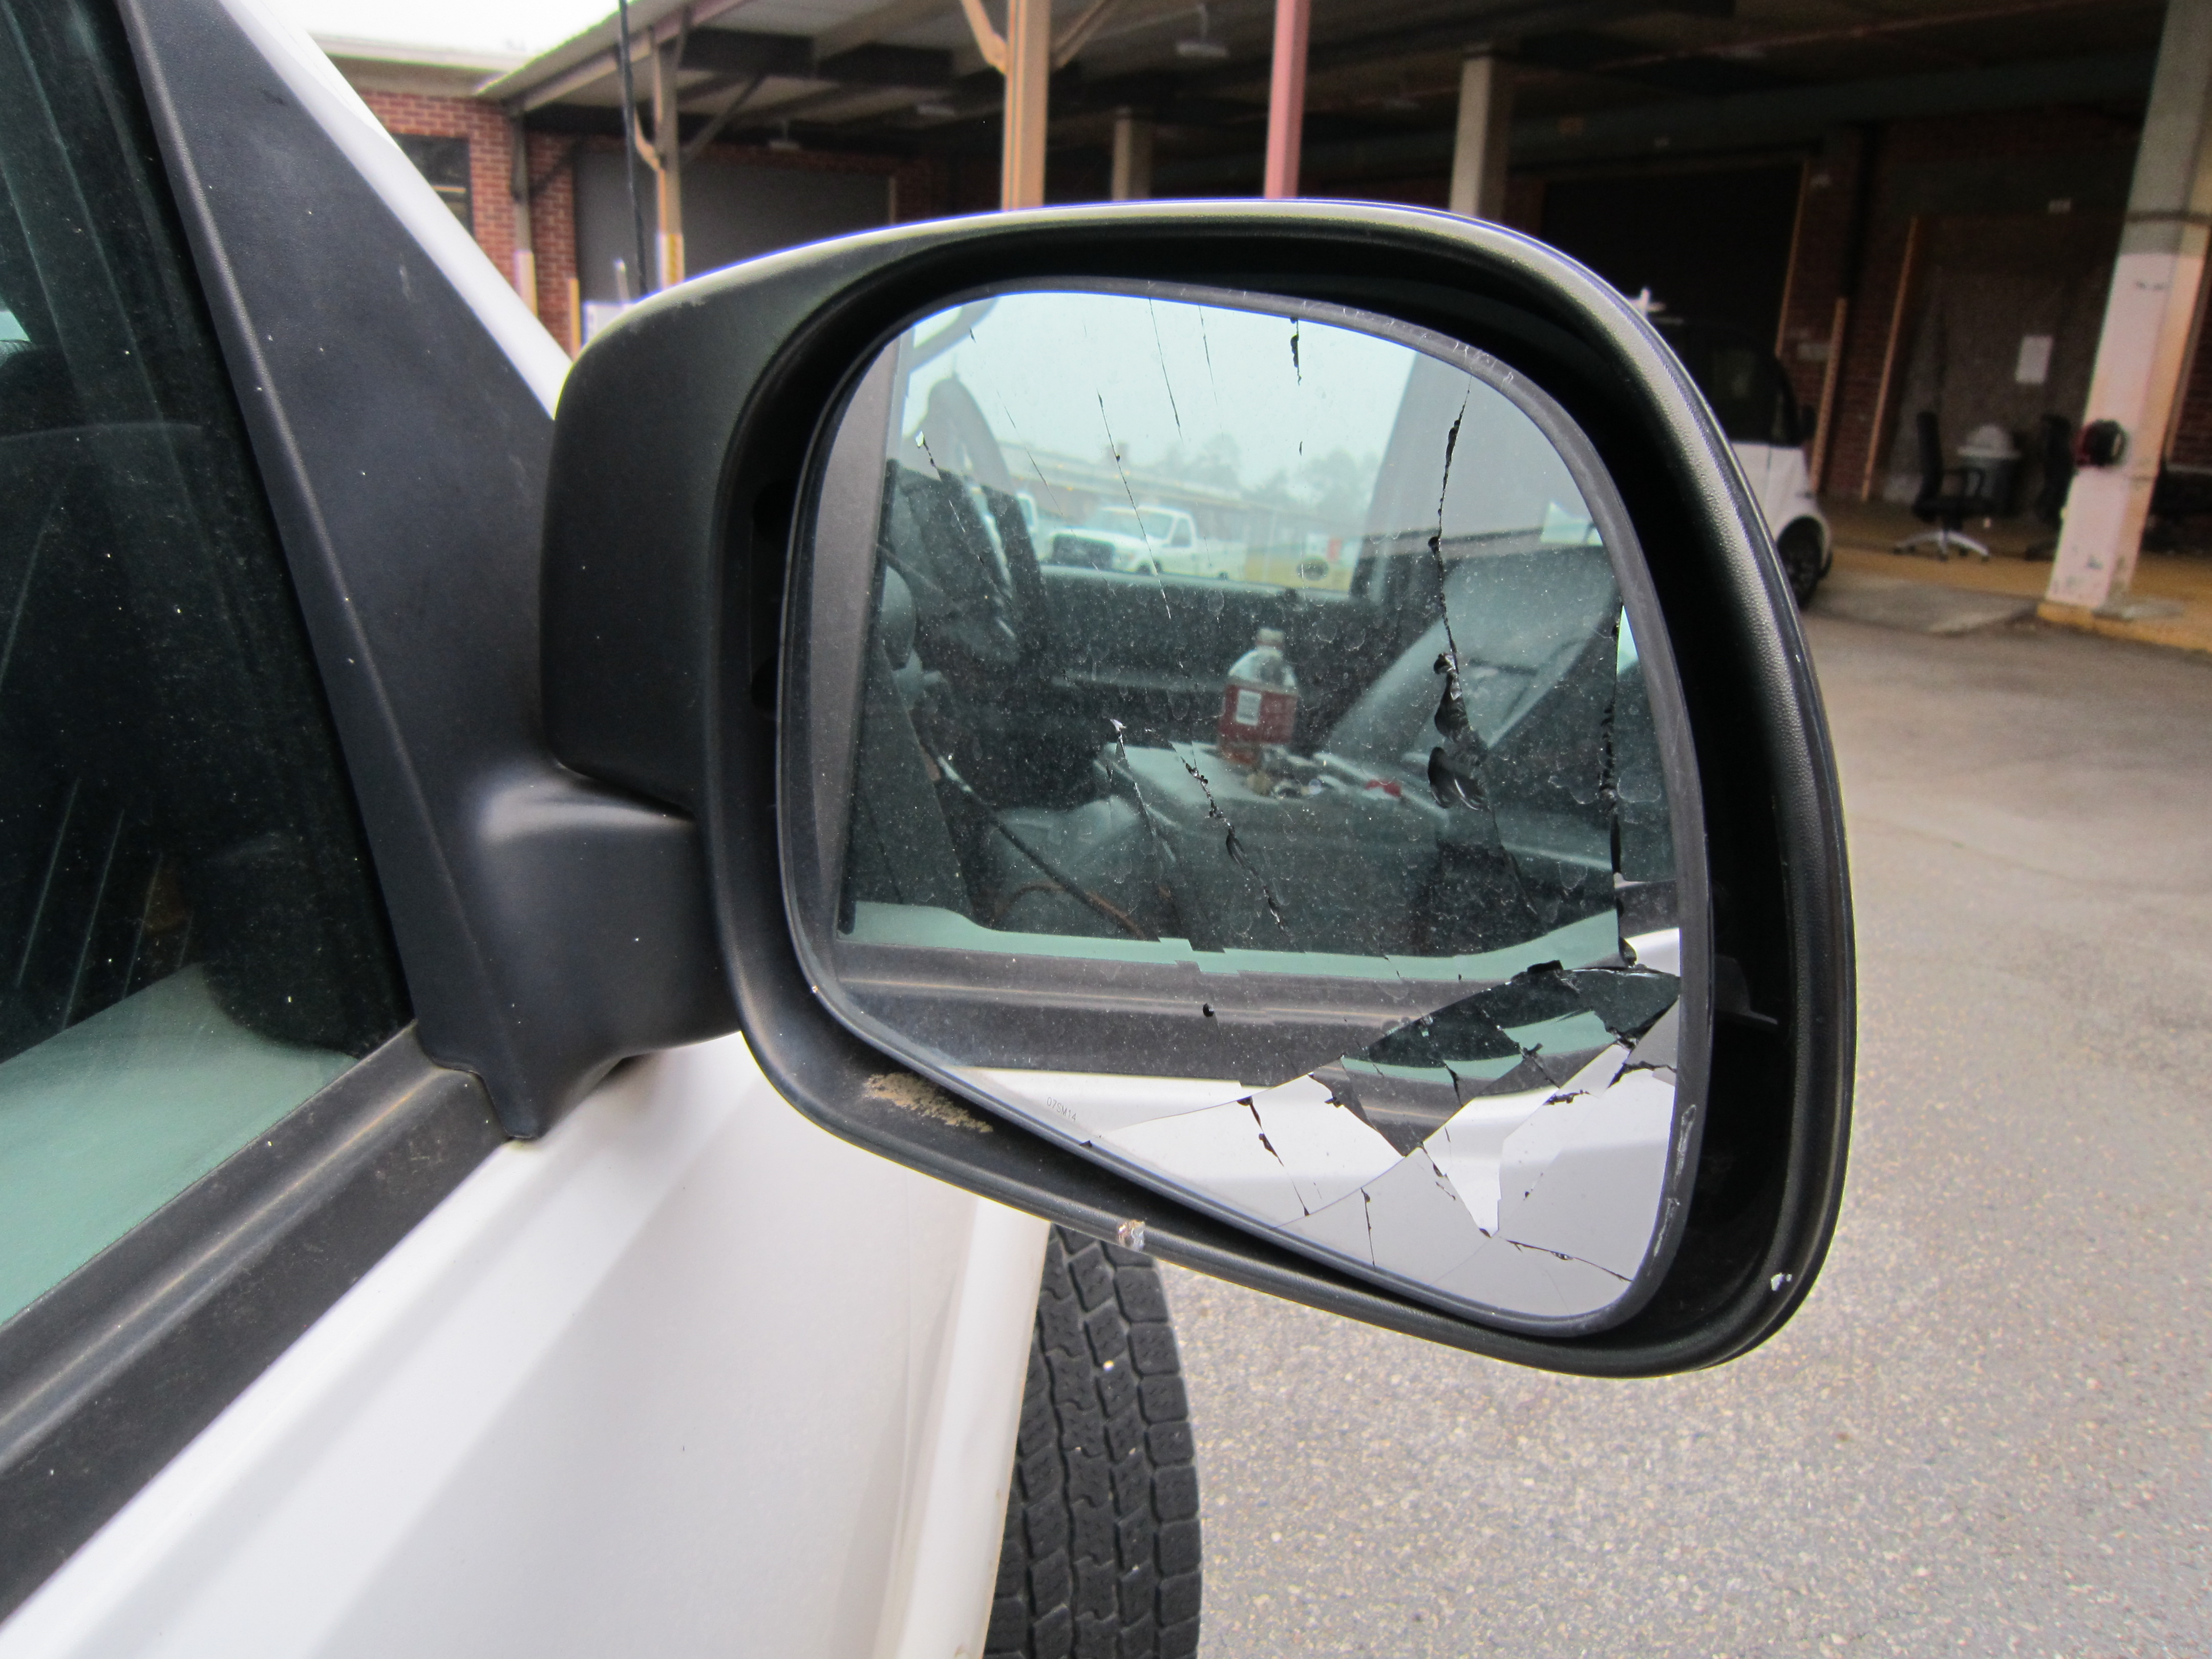
Property Damages
LSD – GOV struck electric cord reel while backing up, causing damage to passenger side mirror
$100.00

Slide 31


Driver Education Program
CY24
Course | Alive at 25 | Attitudinal Dynamics of Driving (ADD)
Hours | 0730 -1200 | 0800-1500
Location | HRO, Bldg. 3010 | HRO, Bldg. 3010
Required For | Marines under age 26 | Drivers designated by the Base Traffic Court
Available For | Marine and Civilian Marine, family members ages 15-25 | Drivers designated by the Base Traffic Court
Dress/Uniform | Marines: Uniform of the day Civilians: Business casual | Marines: Uniform of the day Civilians: Business casual
Available Training | All dates are tentative based on number of enrollees. Thursday, 13 Mar 25 Thursday, 15 May 25 Thursday, 17 Jul 25 Thursday, 18 Sep 25 Thursday, 20 Nov 25 | The ADD course is taught as needed, minimum personnel required 10 students. The Base Traffic Court appoints required ADD course to on-base drivers who are convicted of a moving traffic violation.
1. Reference: MCLBAO 5100.19A dated 4 Dec 20 2. Reference: MCO 5100.29 C Alive At 25; Volume 3, Chapter 2, Para 021001 – All military personnel under the age of 26 will complete a traffic safety course. Marines under the age of 26 first gaining unit will ensure the Marines receive at least four hours of driver’s awareness training within 60 days of reporting to the Command. Training will include at least 30 minutes of local traffic familiarization. Attitudinal Dynamics of Driving (ADD); Volume 3, Chapter 2, Para 021002 – Anyone convicted of a moving traffic violation or who is found at-fault in a motor vehicle mishap while operating any GOV will attend a remedial driver training course. The remedial course will provide 6 to 8 hours of classroom instruction.
POC for all traffic training:
Jon Peacock @ (229) 639-7050

Slide 32

Motorcycle Training status as of 7 Jan 24
The MCLB Albany Motorcycle Riders Club and MARCORLOGCOM Riders Club held an MMP meeting on 31 Jan 25. The next scheduled Advanced Riders Course is on 28 Feb 25.
Albany Riders Club
Jon Peacock
Traffic Safety Program Manager
(229) 639-7050
MSgt Brown
MCLBA Motorcycle Mentorship
Program POC
(229) 639-7489
Notes:
Alive @ 25 on Thursday, 24 June 21; 4 attendees completed instruction. (4 Marines)
Alive @ 25 on Saturday, 17 July 21; 13 attendees completed instruction, but on next quarter’s slides. (8 Civilian & 5 Marines)
ADD Course on Thursday, 22 July 21; 1 attendees completed instruction, but on next quarter’s slides (1 Civilian)
When gathering data, ensure we get total attendees, break down by Military or Civilian, and number of No-Shows.

Slide 33

MCFD – 1st Qtr. FY25
Prevention Section
FY-2025 | 1st QTR | YTD
Inspections | 80 | 80
Violations Open | 31 | 31
Violations Closed | 46 | 46
On the Spot Corrections (OSCs) | 3 | 3
Hot Work Permits Issued (HWPs) | 14 | 14
Per MCLBAO 11320.2G, Directors and Branch Heads are appointed Area Fire Marshals & are responsible for the Fire Prevention programs in their areas of responsibility.
Branch Heads appoint in writing a Fire Warden who will be responsible for executing and implementing the fire prevention program within their building, facility or areas.
Appointment letters shall be sent to the Fire Prevention Chief Charles Thurmond at:
charles.thurmond@usmc.mil
Each tenant within a facility shall have a Fire Warden assigned.
Total Fire Wardens Trained for 1st QTR: 14
Notes:
Double click graph to input data

Slide 34

MCPD – 3nd Qtr. CY24
Reported Traffic Collisions
GOV
POV
VEHICLE TYPE | Quarter | YTD
GOV - GOV | 0 | 0
GOV - POV | 0 | 1
GOV - Fixed Object | 1 | 4
GOV - Animal | 0 | 1
GOV - Pedestrian | 0 | 0
GOV - Bicycle | 0 | 0
GOV - Rollover | 0 | 0
Hit & Run (GOV) | 0 | 0
Total | 1 | 6
VEHICLE TYPE | Quarter | YTD
POV - POV | 1 | 3
POV - GOV | 0 | 0
POV - Fixed Object | 0 | 2
POV - Animal | 0 | 1
Hit & Run (POV) | 0 | 0
POV - Bicycle | 0 | 0
POV - Rollover | 0 | 0
Motorcycle | 0 | 0
Total | 1 | 6
No update provided
Reported “Motor Vehicle” Collisions (Off Road Damage to Property)
VEHICLE TYPE | Quarter | YTD
GOV - GOV | 0 | 2
GOV - POV | 0 | 0
GOV - Fixed Object | 4 | 11
Total | 4 | 13
VEHICLE TYPE | Quarter | YTD
POV - POV | 3 | 6
POV - GOV | 0 | 1
POV - Fixed Object | 0 | 2
Total | 3 | 9
34
Notes:
34
PMO

Slide 35

MCPD – 3rd Qtr. CY24
No update provided
Notes:
35

Slide 36
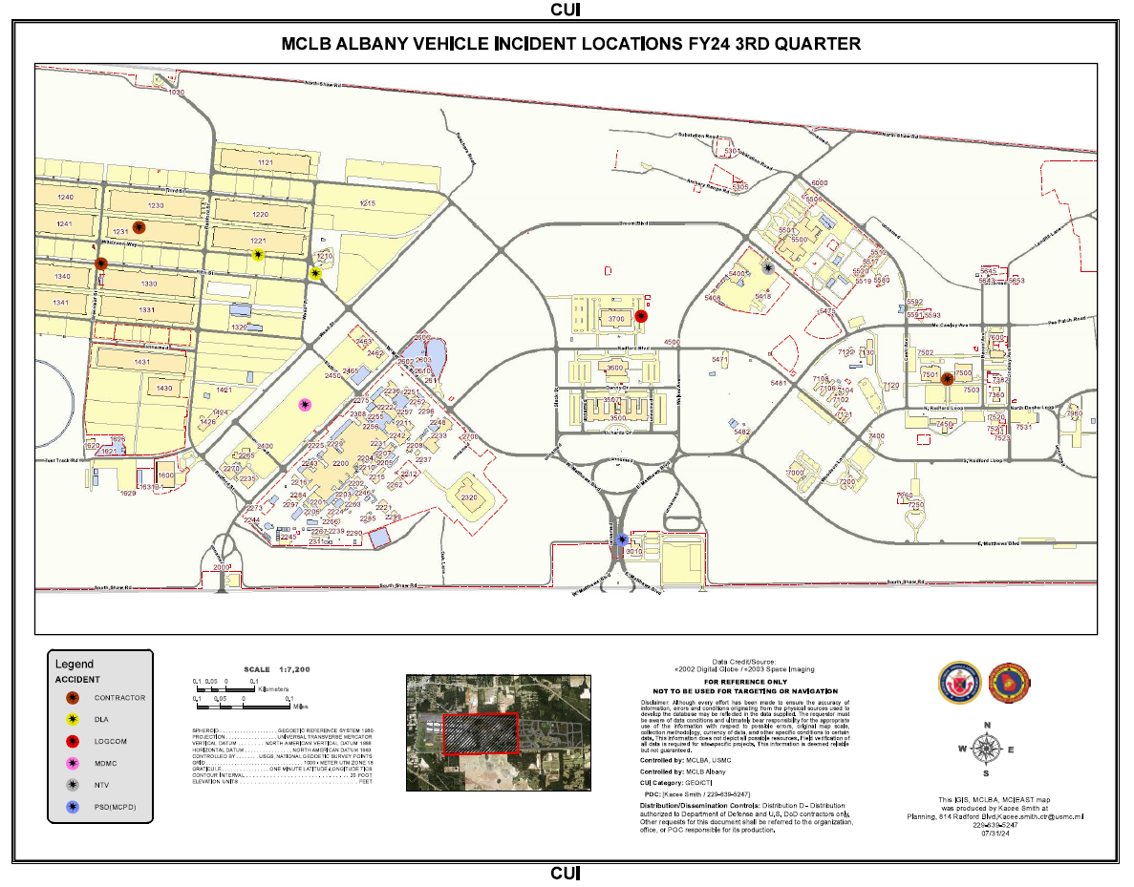
No update provided

Slide 37
Roadmaster Incident Stats
Quarter | Date | Type of Stop (Accident/Citation/Safety | Unit/Section | Recommended Actions
^{4rd Qtr.} | 05 Nov 24 | Accident | Base/LSD | Remedial Driving Training
 | 07 Nov 24 | Accident | Base/LSD | Remedial Driving Training
 | 19 Nov 24 | Accident | Base/SAF | Remedial Driving Training
MSgt Jerry Williams
Roadmaster
(229)639-5606
Notes:
Units with a reported mishap or injuries will brief their information.
Brief by exception. Slides are hidden, but we maintain the data.

Slide 38

Injury Compensation
Federal Workers’ Compensation Program
Employees’ Compensation Operations & Management Portal (ECOMP) has become the preferred vehicle for processing new employee injury claims electronically.
All injuries should be reported using the electronic CA-1 or CA-2 forms which are within the ECOMP System
CA-1 and CA-2 forms should be processed by supervisors through the ECOMP System no later than 4 days following their employee’s injury as mandated by MPC-40.
Injury Status
Oct. | One injury. Employee is back at work.
Nov. | No injuries reported.
Dec. | No injuries reported.
Shelia Lester Florence Abria Johnson
Injury Compensation Program Administrator Alternate Injury Compensation Program Administrator
(229) 639-5244 (229) 639-5255

Slide 39
Annual Drug Testing Results (2020 thru 2025)

Slide 40


Radiation Safety Program
Activities:
  10 Oct 24: Received 47 M67 Sight Mounts from General Accounts.
  22 Oct 24: Participated in the RAD Emergency Drill with MDMC.
Current inventory as of 31 Dec 2024:
  One (1) Telescope Elbow (MCSF-Blount Island Command).
  Twenty-Five (25) Aiming Post Alignment Devices (LSD).
  Forty-Seven (47) M67 Sight Mounts (General Accounts) .
Johnny Little
Radiation Safety Manager
(229) 639-6721

Slide 41


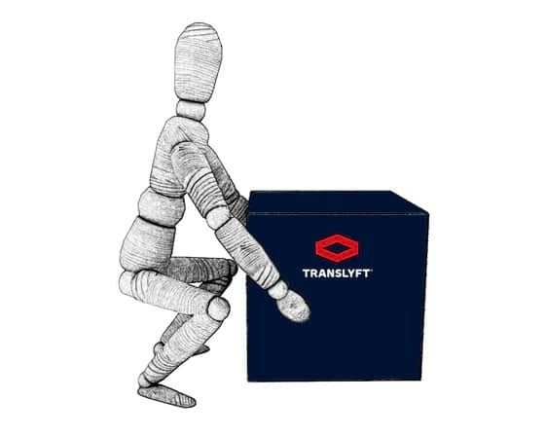


Ergonomics
FY25 Council Theme:
VPP and Ergonomics
2. Worksite Analysis
The purpose of an ergonomics worksite analysis is to identify existing hazards that may cause work-related musculoskeletal disorders (WMSD) and other injuries.
Work-related Musculoskeletal Disorders (WMSDs) are MSDs that are caused or made worse by work methods and environment. They occur when the physical capabilities of the worker do not match the physical requirements of the job.
Common WMSDs: Tendonitis, Bursitis, Trigger Finger, Carpal Tunnel Syndrome, Back Strain.
Resource: Ground Safety for Marines (GSM) course manual, chap. 260, Ergonomics and VPP Elements
Juan Escovar
Ergonomics Program Manager
(229) 639-5625
ergonomics is the practice of fitting the workplace to the worker, not fitting the worker to the workplace. Ergonomics considers body dimensions, mobility, and the body’s stress behavior in the design of jobs, equipment, and work tasks

Slide 42
ALCOHOL/URINALYSIS SCREENING PROGRAM
FY24 4th QUARTER TESTING RESULTS
SACO
0 = Alcohol Related Incident (ARI) for 4th Qtr
0 = Drug Related Incidents (DRI) for 4th Qtr
0 = Tested “Positive” of .02 or above for Breathalyzer Screening
Oct
10 - MARINES REPORTED FOR RANDOM BREATHALYZER
10 - MARINES WERE TESTED FOR THE MONTH- URINALYSIS
0 - TESTED POSITIVE FOR BREATHALYZER / URINALYSIS SCREENING
Nov
15 - MARINES REPORTED FOR RANDOM BREATHALYZER
20- MARINES WERE TESTED FOR THE MONTH- URINALYSIS
0 - TESTED POSITIVE FOR BREATHALYZER
Dec
15 - MARINES REPORTED FOR RANDOM BREATHALYZER
28-MARINES WERE TESTED FOR THE MONTH- URINALYSIS
0- TESTED POSITIVE FOR BREATHALYZER
0- TESTED POSITIVE FOR URINALYSIS SCREENING
SSgt Johnson Isaiah
Substance Assessment Coordination Officer
229-639-9106

Slide 43



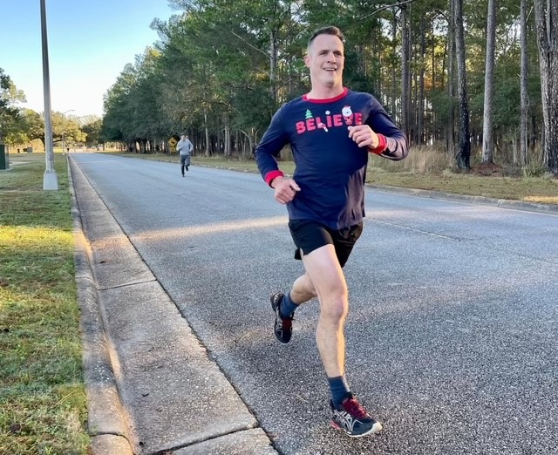
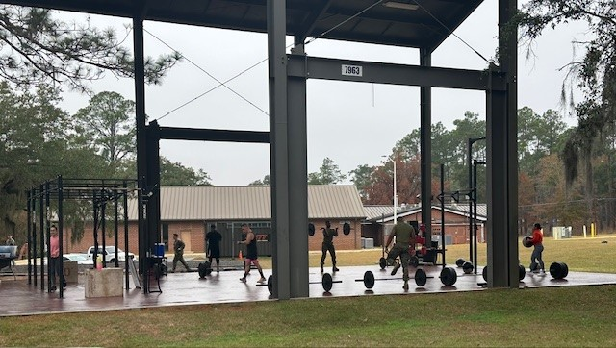
Recreation and Off-Duty Safety (RODS)
Reviewed the following Deliberate Risk Assessment Worksheets (DRAW) from JRAT:
1. HITT 12 Days of Christmas
2. 3 V 3 Basketball
3. Cupid Shuffle Fun Run
Attended Annual Armed Forces Challenge Planning Meeting
Whitney Hendrix
RODS Program Manager
(229) 639-7052

Slide 44

Explosives Safety
Explosive Safety Self-Assessment was completed on 10-11 November: 1 Program Finding
MCPD K-9 CETASM: Draft of CETASM SOP is currently under review.
Explosives Safety Officer
Rashode L. Best
(229) 639-6215

Slide 45
Hearing Conservation
Hearing Readiness Metrics CY24
(as of 31 Dec 24)
Reference: MCO 6260.3A, Marine Corps Hearing Conservation Program
Training requirements
Audiogram (Baseline, Annual, and Termination)
STS/PTS
Fit Testing
Identifying noise hazardous area and equipment
Best way to manage the program is by using ESAMS
Alisha Montieth
Safety Specialist
639-7272
Notes:
Sir, we are briefing this slide , which was suggested by MCI as a way to provide the CO with a Hearing Readiness Status .
The Data on this side comes from ESAMS and MRRS
This slide covers the requirement for MCO 6260.3A, Marine Corps Hearing Conservation Program and the Readiness Metrics for CY20.
The Hearing Conservation Program’s requirements includes: Training, Audiogram, Significant Threshold Shift (STS) , Fit Testing , noise hazardous area and equipment inventory, etc.
Displayed on the chart, we have 192 personnel enrolled in the Hearing Conservation Program which are broken down by Department for CY20.
So far this calendar year, we currently have 151 audiogram that are in compliance.
We had No reported STS.
There are 6 termination audiogram reported and six baseline audiogram reported for the year.
Our Audiogram Compliance (AC) Rate is approximately 78%,.
The STS Rate is zero %.

Slide 46
MCLB Albany Medical Surveillance Program
(As of 31 December 2024)
Total % Compliant: 90.0 (530/589)
MCLBA Compliant (90% or >)
Marine Corps Compliant (85% or >, but <90%)
Non-Compliant (<85%)
Stacey Williams
Occupational Health Program Manager
(229)639-7049

Slide 47

Naval Medicine Readiness & Training Unit
Albany, GA
Occupational Health
Industrial Hygiene Survey Schedule
FY25 1st & 2nd Quarter
Division | Hazard Category | IH Survey Due Date
Marine Forces Reserves General Account | 2 | December 2024
DLA – Disposition Services | 3 | January 2025
DLA – HQ Customer Support | 3 | January 2025
Humanitarian Assistance Program | 3 | February 2025
MCLB – HQ and Special Staff | 3 | March 2025
MCLB – Office of the Comptroller | 3 | March 2025
No update provided
LADONNA SCHEURER
INDUSTRIAL HYGIENIST
NMR&TU Albany IHPO
229-639-7846
JONATHAN RITTER
INDUSTRIAL HYGIENIST
NMR&TU Albany IHPO
229-639-6408

Slide 48
GREAT SAFETY TRAINING OPPORTUNITIES
What: | VPP 101 | Safety Leaders Workshop
Who: | New employees and Marines that have not previously attended the course. | New supervisors and managers that have not previously attended the course. Employees are encouraged to attend.
When: | 6 February 2025, 0900-1000 6 March 2025, 0900-1000 3 April 2025, 0900-1000 | 3 – 4 June 2025
Where: | Building 3500, Wing 500, Room 504 | I&E Training Room – Bldg. 5500
Why: | MCLB Albany is an OSHA VPP Star Site, this training will help new employees and Marines understand what VPP is and learn how they can help the Command maintain Star status. | To impart a stronger sense of awareness of safety issues to the workforce and increase employee’s understanding of the impact and importance of a robust and effective safety and health program.
How: | Please contact your division training coordinator to reserve your seat.
Supervisors needing Safety Leader’s Workshop
Name |  | Division | Name |  | Division | Name |  | Division
1 | Christopher Mercer | PSD | 7 | Alejandro Nanez | PSD | 13
2 | SgtMaj Frank Kammer | Special Staff | 8 | Teddrick Parks | MCCS | 14
3 | Col Matthew McKinney | Special Staff | 9 | Vondrell Patrick | HQ Co | 15
4 | MSgt Brian Dawson | LSD | 10 | Robert Richards | PSD | 16
5 | Capt Brian Hanna | HQ Co | 11 | David Ward | OTD
6 | Jonathan Caylor | PSD | 12
Notes:
Report pulled via ESAMS as to who needs the SLW forecasted out to 11/21/22.

Slide 49
GREAT SAFETY TRAINING OPPORTUNITY
What: | MCLB Albany Ground Safety for Marines (GSM) Course
Who: | All Safety and Occupational Health Professionals, Collateral Duty Safety Officers, Ground Safety Officers, and Ground Safety Managers.
When: | 24 February – 7 March 2025
Where: | Building 7120
Why: | This course is required for all Safety and Occupational Health Professionals, Collateral Duty Safety Officers, Ground Safety Officers, and Ground Safety Managers.
How: | Leadership must submit their nominations via email to Rashode.best@usmc.mil and Thomas.mullen@usmc.mil
Notes:
Report pulled via ESAMS as to who needs the SLW forecasted out to 11/21/22.

Slide 50


Status of Formal Safety Training by Position
Unit | Name | Position | Trained | Course Schedule
HQ & Staff | LtCol Christian Felder | Command Safety Officer | Yes | Ground Safety for Marines CY24 MCB CAMLEJ 14 Apr – 25 Apr 25 2 Jun – 13 Jun 25 15 Sep – 26 Sep 25
HQ Company | SSgt Kevin Chapman | Company Safety Officer | 26 Jul 24
Comptroller | Mrs. Sandra Howard | Safety Representative | Not Required
LSD | Mr. Dayne Leininger | Safety Officer | 28 Oct 22
OTD | Mr. Anthony Wade | Safety Representative | Not Required
CISD | Mrs. Tammy Sisai | Safety Officer | 18 Dec 15
I&E | Mr. Frederick Peoples | Safety Officer | 17 May 24
PSD | Mr. Manual Gray | Safety Specialist | 05 Feb 16
 |  |  |  | Ground Mishap Investigation Course CY24 MCB CAMLEJ 28 Apr – 2 May 25 8 – 12 Sep 25
MCCS | Vacant | Safety Officer
PPA | Mr. Joseph Carson | Safety Manager | Yes
SYSCOM | Mr. Jeffrey Wilson | Safety Officer | 9 Mar 07
MFSC | Vacant | Safety Manager | 6 Mar 09
DDAG | Marisa Shorter | Safety Specialist | (7 Mar 25)
General Accounts | Cpl Christopher Casilla | Safety Officer | 28 Oct 22
Marine Corps Safety Management System (MCSMS) 5100.29C, Chapter 5, Para 050302.C, dtd 15 Oct 20
Safety Officer Training: Commanders shall ensure that safety officers attend the Ground Safety For Marines Course (CIN# A-493-0047) within 90 days of assignment. ISMs will track and document training of all safety officers.

Slide 51



VPP ACTIVITIES
Completed for CY24
1. | Two SGEs assisted with VPP Onsite – Southwire Company Metal Clad Plant, Carrollton, GA, 22-25 Jan 24
2. | OSHA VPP Self-Evaluation submitted on 13 Feb 24
3. | Two safety specialists visited Cardinal Glass in Adel, Georgia for VPP Mentoring, 15 Apr 24
4. | Three SGEs visited Cardinal Glass in Adel, Georgia on 28 May 24
5. | Two Risk Management personnel attended SGE training course at the Region IV VPPPA Conference
6. | Four Risk Management personnel attended the Region IV VPPPA Conference and provided instruction on “How Can You Engage Employees In your SMS”
7. | Two SGEs assisted DOD SMCX with Beaufort Air Station Readiness Assessment, 29 Jul – 2 Aug 24
8 | VPPPA 2024 Safety National Symposium, Aurora, CO, 25-29 Aug 24
Scheduled for CY25
1. | VPPPA 2025 Safety & Health Excellence Conference, Stone Mountain GA, 6-8 May 25
2. | VPPPA 2025 Safety Symposium, St. Louis, MO, 11-14 August 25
Notes:
VPP Status Update..

Slide 52
CY24 Safety Award for 4th Quarter
CO’s Safety Division Quarterly/Yearly Award Criteria will be based on the Division that earns the Highest Total Points, which involve the Four Elements of VPP. The formula for calculating total points earned is as follows: VPPSC Participation + Near Miss Report + Hazard Abatement + Training (ESAMS).
Management Leadership & Employee Involvement
Worksite Analysis
Hazard Prevention & Control
Safety & Health Training
Table 1: VPPSC Participation
Ranking Order | Points Earned
If member(s) from your division attend all scheduled VPPSC Meeting(s), the impact could be as much as 30 points earned. The points earned are assessed below.
Absentee | Points Earned
0 | 30 Points
1 | 15 Points
2 | 5 Points
> 2 | 0 Points
100% Participation | 30 Points
Table 2: Near Miss Report
Ranking Order | Points Earned
1st | 10 Points
2nd | 9 Points
3rd | 8 Points
4th | 7 Points
5th | 6 Points
6th | 5 Points
7th | 4 Points
8th | 3 Points
No Near Miss Report | 0 Points
Table 3: Hazard Abatement
Ranking Order | Points Earned
1st | 25 Points
2nd | 23 Points
3rd | 21 Points
4th | 19 Points
5th | 17 Points
6th | 15 Points
7th | 13 Points
8th | 11 Points
100% Hazard Abatement | 30 Points
Table 4: Training (ESAMS)
Ranking Order | Points Earned
1st | 25 Points
2nd | 20 Points
3rd | 18 Points
4th | 16 Points
5th | 14 Points
6th | 12 Points
7th | 10 Points
8th | 8 Points
100% Required Training | 30 Points
Notes:
1 The maximum number of points a division can receive is 100 points.
2 Risk Management will query near miss report and training records in ESAMS for the previous CY Quarter/Year.
3 Risk Management will calculate each division near miss rate and training completion rate and rank rates from highest to lowest.
4 Risk Management will query ESAMS and determine the Hazard Abatement for each division and rank order from highest to lowest.
5 Using Table 1, add your VPPSC Participation points earned to your running score.
6 Using Table 2, add points earned according to your division's Near Miss Report ranking order to your running score.
7 Using Table 3, add the Hazard Abatement points earned according to your division ranking to your running score.
8 Using Table 4, add the Training (ESAMS) points earned according to your division's Training Ranking order to your running score.
9 Risk Management will rank final scores of each division.
10 The division with the highest total points earned will be selected as the Safety Award Winner for the Quarter/Year.

Slide 53

CO Guidance
Mark your Calendars
The next Safety Officer’s Council is:
30 Apr 25
The next Commanding Officer’s Safety Council is:
7 May 25

